Slide 1
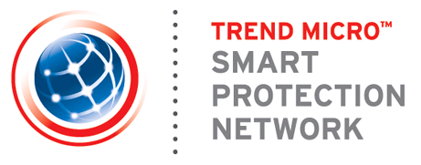
Smart Protection Network
Kelvin Liu
AVP, Core Tech Development
Notes:
Hi, welcome to the Smart Protection Network presentation.

Slide 2

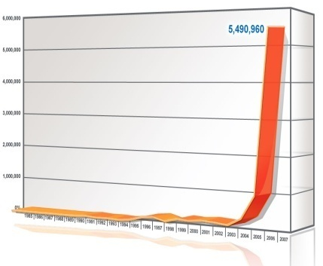
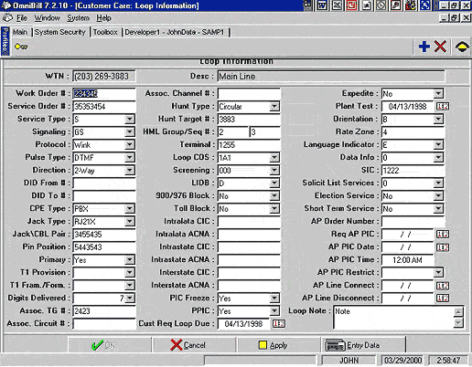



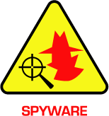

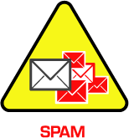

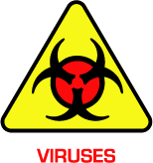

Evolving Threat Landscape
Malware is
multiplying
Malware is
sophisticated
Malware is
profit driven
Complexity
Botnets
Web
Spam
Spyware
Worms
Malware is getting increasingly dangerous
and harder to detect.
Notes:
2
The era of global outbreaks is over. Today’s generation of threats have the following characteristics:
Targeted – Rather than attempting to perform infections on a global scale, threats nowadays are more regional. The social engineering techniques they use are more tailored for the specific region they are targeting, using local language or local news. Some threats even go as far as targeting a specific person within the company (such as the CEO or other high level executives)
Stealthy – Earlier malware, motivated by fame, usually did not go through any effort in hiding themselves from the user. Some were even as blatant as changing the user’s icons to signify that they have been “owned” by the malware. However, these days, the malware go through great lengths to avoid detection. They utilize rootkit techniques and disable antivirus software to hide their presence on the desktop. To hide their network activities, they use a variety of techniques such as encryption, usage of alternative protocols and masquerading as legitimate traffic.
Profit-driven – The new wave of malware are now being written by crime-rings that are intent on making a profit. They are very organized and systematic in their approach. To maximize their profit, they go through stringent quality assurance processes on their malware to ensure that they are not detected by existing antivirus products. They make money by stealing the user’s confidential information such as passwords and bank accounts and silently transmit them back to these criminal groups

Slide 3
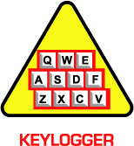
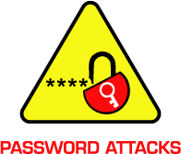
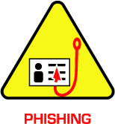
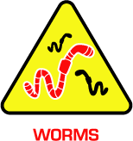





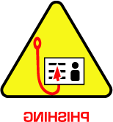
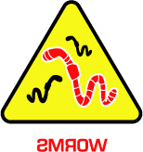

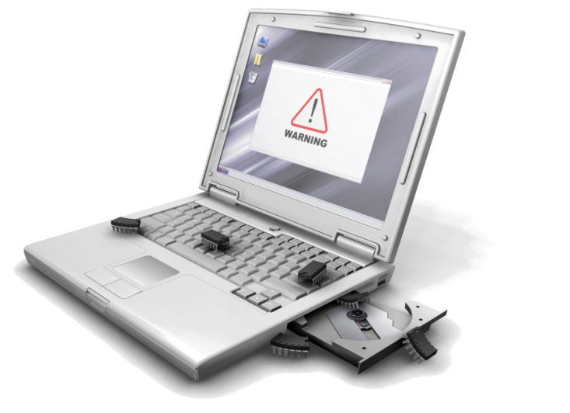
Example : Conficker / Downadup
User receive a spam mail
Internet
User open the mail then automatically download a file
Connect to various websites, download other malicious files
The file register itself as a system service
Monitor the Internet browser’s address bar
Block access to certain websites
Notes:
During today’s presentation we will cover a variety of topics. We’ll start with an overview of the changing threat landscape, explain what Smart Protection Network is and does and then wrap it up with any questions you may have.
3

Slide 4



Smart Protection Network against Conficker
Many clients’ processes are dropping similar filenames in a short time
Community Intelligence
Many clients access or modify the same system file in a short time
Many clients accessed similar/same registry keys in a short time
Incident
Trigger
Customer
Feedback Log
File
Reputation
Correlation
Web
Reputation
Monitor
Smart Protection Network
Immediate
Protection
Correlate to figure
out where the threat
come from & where
it would connect to
Email
Reputation
File | Score | From | Connect to
Crypt.NS.Gen | X | 129.24.11.3/aexjiire/ | Euwl.tsst.com:88/e34jg/
Dropper.Gen | X | Ndj.sexadult.com/ssr/ee | 112.42.5.112:80/
Nqe.exe | V | www.xyz.com | www.abc.com
Conflicker_D | X | qd.wqwwor.com/om | nadasm0.info:80/bugsy
Conflicker_D | X | Fdjhg.wopqfe.com | 7f7fewf.cn:80/sina/
Notes:
4

Slide 5
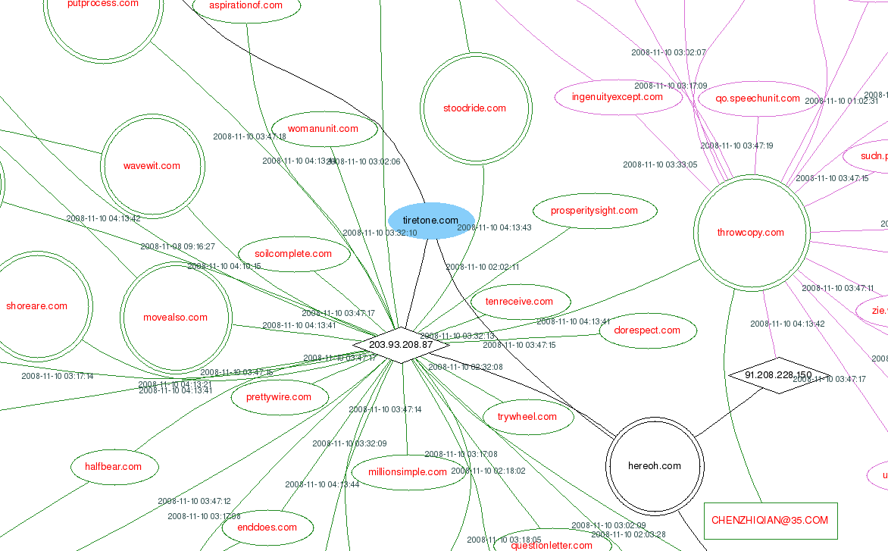
Smart Protection Network against Conficker
Threat Intelligence
Incident
Trigger
File
Reputation
Correlation
Correlation
Web
Reputation
Monitor
Immediate
Protection
Email
Reputation
Domain / Name Server / IP / Register’s Email Correlation
to build up a Spider Network
Notes:
5

Slide 6
Smart Protection Network against Conficker
Threat Intelligence
Incident
Trigger
File
Reputation
Correlation
Correlation
Web
Reputation
Monitor
Immediate
Protection
Email
Reputation
Domain / Name Server / IP / Register’s Email Correlation
to build up a Spider Network
Notes:
6

Slide 7
What & How Trend Micro use Cloud Computing
Proactive sourcing
Customer
User traffic log
Customer
HTTP
DNS
FTP
Monitor
Incident Trigger
Correlation
Correlation
Clustering
Analyzer
Clawer
MapReduce
Data Processing
Tracking System
Hadoop ( HBASE / Meta Data )
Data Archive
Message Routing framework
Hadoop (HDFS)
Infrastructure
Virtualization
Operating system
OS
Server Farm
Smart Protection Network

Slide 8

Why Smart Protection Network
Time to Protect
Threat Intelligence
Immediate Protection
Early Warning
Threat Lifecycle Management
Less Complexity
Reduce Cost
Lightweight Clients
Less Memory Usage
Reduce Downtime Costs
Reduce Hardware Costs
Notes:
8

Slide 9


Slide 10
Thank You
業務專線 : (02) 2378-2666
Notes:
Hi, welcome to the Smart Protection Network presentation.

