Slide 1
Introduce File Systems – EXT2/3 and BTRFS
Yang ShunFa

Slide 2
Outline
Introduce File System
EXT2/3 Design
BTRFS Design
  B-tree Data structures
  File System Data Structures
  Copy on Write Logging
  Other Characteristics
Measure the Access Time between EXT3 and BTRFS

Slide 3
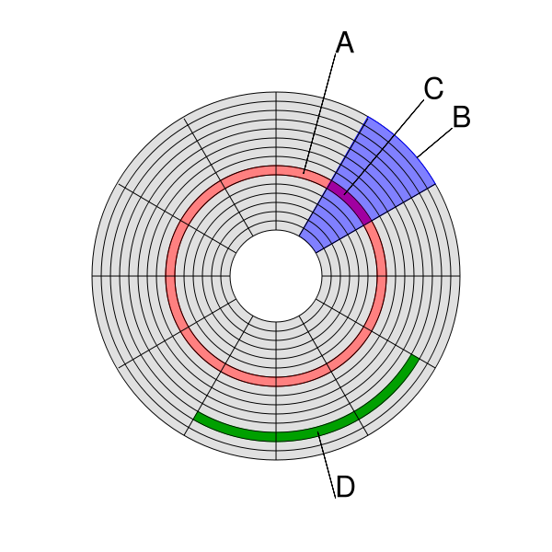
Introduce File System
Storage Device – Hard Disk Structure
  (A) track
  (B) geometrical sector
  (C) track sector
  (D) cluster
Ref http://en.wikipedia.org/wiki/Disk_sector
Notes:
B 扇形磁區

Slide 4
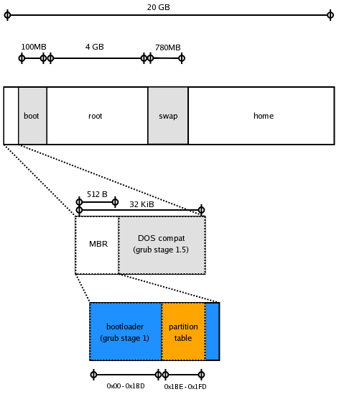
Introduce File System
The structure at the start of a hard disk
Ref http://www.pixelbeat.org/docs/disk/
Notes:
MBR(Master Boot Record)
The master boot record is always located at cylinder 0, head 0, and sector 1, the first sector on the disk.
When a computer starts and the BIOS boots the machine, it will always look at this first sector for instructions and information on how to proceed with the boot process and load the operating system.

Slide 5
Introduce File System
The Concept of File Systems
Cluster
EOF
Data A
Sector(Hard Disk Layer)

Slide 6
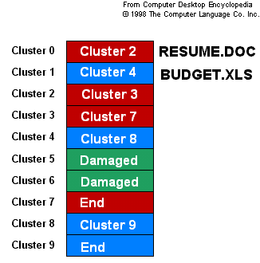
Introduce File System
The Concept of File Systems
Notes:
The file RESUME.DOC is stored in clusters 0, 2, 3 and 7. The directory entry points to cluster 0 where the file begins. The entry for cluster 0 points to cluster 2 and so on. BUDGET.XLS is stored in clusters 1, 4, 8 and 9.

Slide 7
Introduce File System
File System
  store and organize computer files
  easy to find and access files
Proper noun
  Metadata
Types of file systems
  Disk file system, Flash file system
  Database file system, NFS(Network file system)

Slide 8
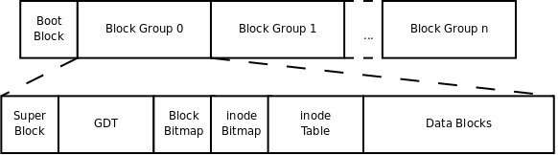
EXT2/3 Design
Physical Structure
Block/inode number, used and non-used block/inode number, block/inode size, mount time……
(Group description)
Notes:
EXT2 檔案系統被建立時，除了有 superblock 外，還會依據 partition 的大小給予數個 block group。 Superblock 記錄資訊主要有： block 與 inode 的總量﹔
未使用與已使用的 inode/block 數量﹔
一個 block 與一個 inode 的大小﹔
檔案系統的掛載時間、最近一次寫入資料的時間、最近一次檢驗磁碟的時間等﹔
valid bit(0 表示已被掛載﹔1 表示未被掛載)。
每個 block group 包含：
Group description：記錄此 block 由何處開始記錄﹔
Block bitmap：記錄那個 block 有沒有被使用﹔
Inode bitmap：記錄那個 inode 有沒有被使用﹔
Inode table：每個 inode 資料存儲區﹔
Data blocks：每個 block 資料存儲區。
使用 dumpe2fs 讀取上述 ext2/etx3 檔案系統的資料。 新增一個檔案(目錄)時： 根據 inode bitmap/block bitmap 找到尚未被使用的 inode 與 block﹔
將要新增的檔案之屬性與資料分別記載進 inode 與 block。
更新 metadata(superblock、inode bitmap、block bitmap)：將剛被使用的 inode 與 block 的號碼告知 metadata。
資料的不一致 (inconsistent) 狀態 當檔案寫入硬碟時系統中斷，將產生 metadata 的資料存放區產生不一致的情況。
ext2 檔案系統在重新開機時，會藉由 superblock 中記錄的 valid bit 與 filesystem state 等狀態判斷是否強制進行資料一致性的檢查。
檢查以指令 e2fsck 進行 metadata 區域與實際資料存放區進行比對。
檢查相當費時。
日誌式的檔案系統 EXT3 日誌式檔案寫入步驟：
系統要寫入檔案時會先在日誌記錄區塊中記錄：某個檔案準備要寫入磁碟﹔
開始寫入檔案的權限與資料﹔
開始更新 metadata 的資料﹔
完成資料與 metadata 的更新後，在日誌記錄區塊當中完成該檔案的紀錄。
萬一資料在記錄過程發生問題，系統只要檢查日誌記錄區塊，即可知那個檔案發生問題。
只要針對有問題的檔案進行一致性檢查，不必針對整個檔案系統進行檢查。

Slide 9
Bit map
 |  |  | ● | ● | ● | ● | ●
Block 0 | Block 1 | … | … | Block n

Slide 10
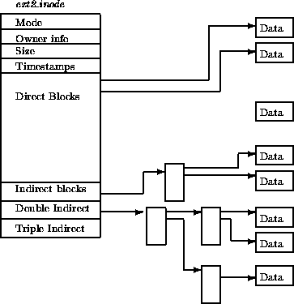
EXT2/3 Design
Data Structure

Slide 11
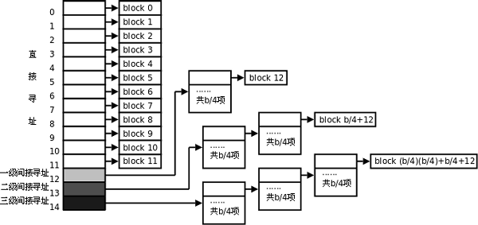
EXT2/3 Design
Direct blocks and indirect blocks

Slide 12
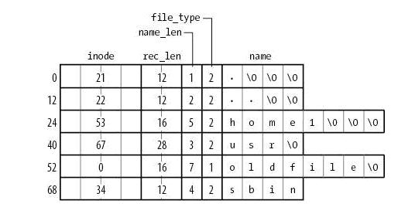
EXT2 directory

Slide 13
BTRFS(Buffer File System)
The main Btrfs features include:
  Extent based file storage (2^64 max file size)
  Space efficient packing of small files
  Space efficient indexed directories
  Dynamic inode allocation
  Writable snapshots (clone)
  Subvolumes (separate internal filesystem roots)
  Checksums on data and metadata (multiple algorithms available)
  Compression
  Support SSD (Solid State Disk)

Slide 14
BTRFS Design
Btree Data Structure
struct btrfs_header {
u8 csum[BTRFS_CSUM_SIZE];
u8 fsid[BTRFS_FSID_SIZE];
__le64 bytenr;
__le64 flags;
u8 chunk_tree_uuid[BTRFS_UUID_SIZE];
__le64 generation;
__le64 owner;
__le32 nritems;
u8 level;
}
struct btrfs_disk_key {
__le64 objectid;
u8 type;
__le64 offset;
}
struct btrfs_item {
struct btrfs_disk_key key;
__le32 offset;
__le32 size;
}

Slide 15
BTRFS Design
Btree Data Structure
root
[key, block pointer]
[key, block pointer]
tree …
tree …
Notes:
The type field in struct btrfs_disk_key indicates the type of data stored in the item.
The offset and size fields in the item indicate where in the leaf the item data can be found.

Slide 16
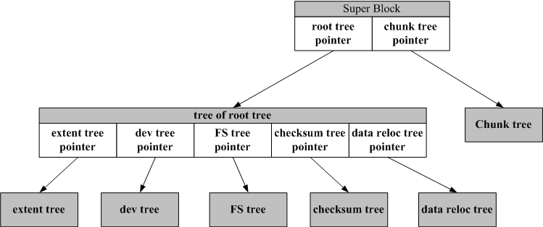
BTRFS Design
Device management
root of each tree
Inode, dir….
Space allocation information
The architecture of BTRFS tree
Notes:
Extent tree 以block group為管理單位，針對大型檔案寫入速度較快，也較ext file system系列有較多彈性化配制的特性，因ext file system採bit map方式記錄free block，若磁碟容量增加，bit map也會越來越大。

Slide 17
Extent tree(BTRFS)
Extent tree
Extent item
Extent item
extent
extent
B0 | B1 | B2 | … | … | … | … | Bn
B0 | B1 | B2 | … | … | … | … | Bn
Extent tree

Slide 18
Extent
B0 | B1 | B2 | … | … | … | … | Bn
Item0… | Item N | Free Space | … | Free Space | Data for Item N… | Data for Item 0

Slide 19

Copy on Write Logging
Superblock
A
A’
A’’
B
B’
B’’
D
C
C’
E
E’
F

Slide 20
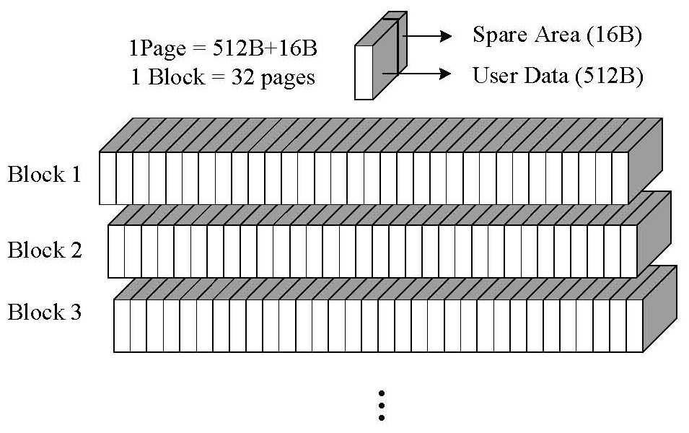
Flash-Memory Characteristics

Slide 21
Other Characteristics
Subvolumes
Snapshots
Delay allocation
Directory index
Compression

Slide 22
Statistics Environment
Hardware
  RAM: 512 MB
Software
  Operation System: Ubuntu 9.04
  Kernel Version: 2.6.31.1
Benchmark
  IOzone

Slide 23
Read Speed

Slide 24
Write Speed

Slide 25
Random Read

Slide 26
Random Write

Slide 27
Reference
Derails of GRUB on the PC
  http://www.pixelbeat.org/docs/disk/
On File Systems
  http://www.kev009.com/wp/2008/11/on-file-systems/
BTRFS
  http://btrfs.wiki.kernel.org/index.php/Main_Page
  http://btrfs.wiki.kernel.org/index.php/Btrfs_design
  http://btrfs.wiki.kernel.org/index.php/Code_documentation
  http://www.ibm.com/developerworks/cn/linux/l-cn-btrfs/index.html
IOzone
  http://www.iozone.org/

Slide 28
Discussion

