Slide 1
Solr Tutorial
Javen Tsai
2013/03/10

Slide 2
Agenda
Introduction
Indexing
Searching
SolrCloud
Q&A

Slide 3
Introduction

Slide 4
What is Solr?
Enterprise search server based on Lucene
  NOT a database
Advanced full-text search capabilities
Flexible and adaptable with XML configuration
Extensible plug-in architecture
REST-like APIs
Web admin interface
Runs inside a Java servlet container such as Jetty and Tomcat

Slide 5
What is Lucene?
Full-text search library
Written in Java
Indexing & searching
One of the top 5 Apache projects

Slide 6
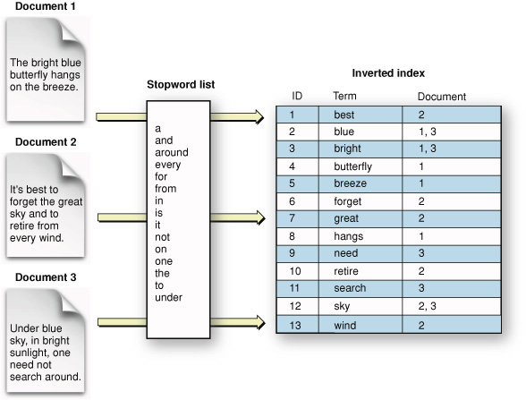
Inverted Index
https://developer.apple.com/library/mac/#documentation/userexperience/Conceptual/SearchKitConcepts/searchKit_basics/searchKit_basics.html

Slide 7









Who use Solr?
https://wiki.apache.org/solr/PublicServers

Slide 8
History
2004 created by Yonik Seeley at CNET Networks
2006/01 donated to Apache
2007/01 graduated from incubation status
2008/09 1.3
2009/11 1.4
2010/03 the Lucene and Solr projects merged
2011/03 3.1
2012/07 3.6.1
2012/10 4.0 (SolrCloud)
2013/01 4.1
http://en.wikipedia.org/wiki/Apache_Solr

Slide 9
Solr Client Libraries / Language Bindings
Java
  SolrJ
JavaScript
PHP
Perl
Python
Ruby
Scala
…
http://wiki.apache.org/solr/IntegratingSolr

Slide 10
Installing Solr
Requirements
  JRE 1.6+
Download
  http://lucene.apache.org/solr/downloads.html
  Latest version 4.1
Run
  tar zxvf ./solr-4.1.0.tgz
  cd ./solr-4.1.0/example
  java [-Dsolr.solr.home=multicore] -jar start.jar

Slide 11
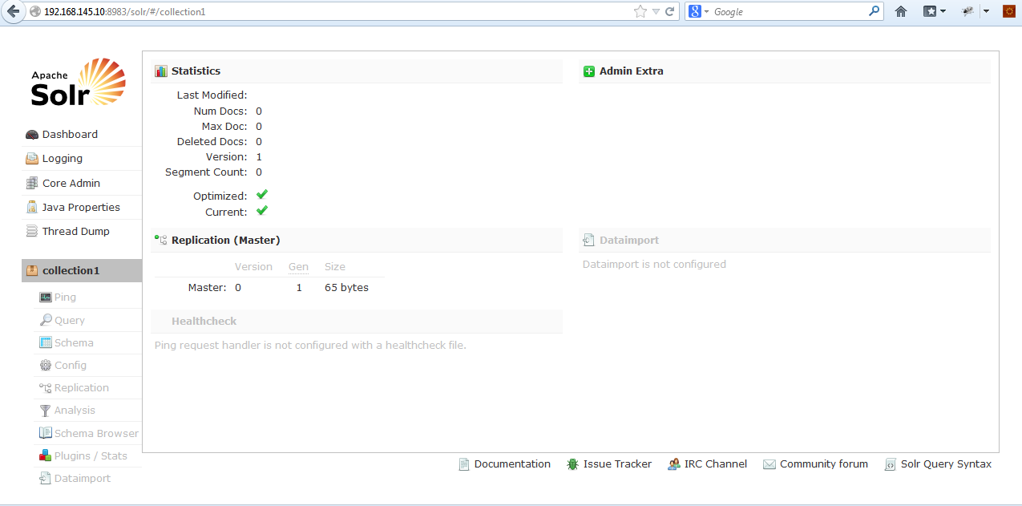
Web Admin Interface
Browse http://localhost:8983/solr

Slide 12
Simple Post Tool
cd ./solr-4.1.0/example/exampledocs
Help
  java -jar post.jar –help
Add documents
  java -Ddata=files -jar post.jar ./*.xml
  java -Ddata=stdin -jar post.jar < mem.xml
Delete documets
  java -Ddata=args -jar post.jar '<delete><id>TWINX2048-3200PRO</id></delete>’
Other options
  -Ddata=files
  -Durl=http://localhost:8983/solr/update
  -Dcommit=yes
http://docs.lucidworks.com/display/solr/Running+Solr

Slide 13
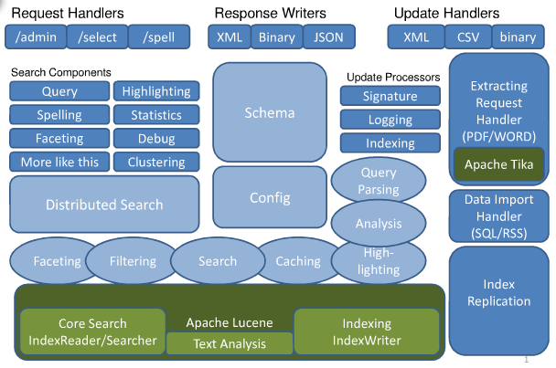
Architecture
http://www.docstoc.com/docs/98318767/Solr-Architecture-(PowerPoint)

Slide 14
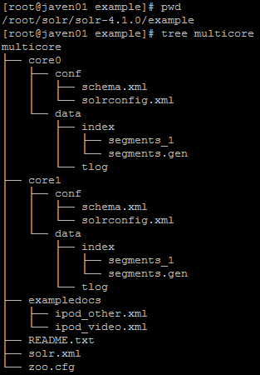
Folder Structure
solr.solr.home
instanceDir
dataDir
instanceDir
dataDir

Slide 15
Configuration Files
${solr.solr.home}/solr.xml
  Specify configuration options for your Solr core
${instanceDir}/conf/solrconfig.xml
  Controls high-level behavior
    Data directory location
    Cache parameters
    Request handlers
    Search components
${instanceDir}/conf/schema.xml
  Describes the documents you will ask Solr to index
http://docs.lucidworks.com/display/solr/A+Step+Closer

Slide 16
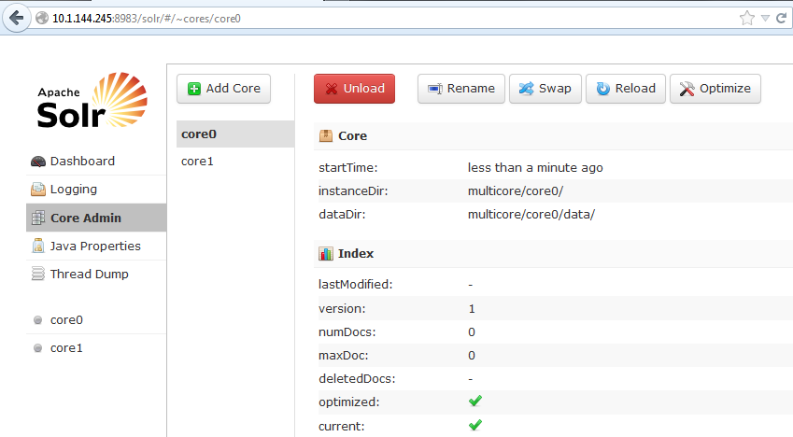
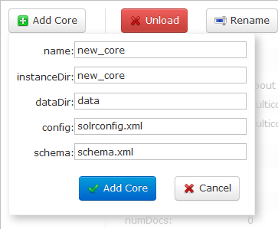
Core Admin
Notes:
http://wiki.apache.org/solr/CoreAdmin
http://docs.lucidworks.com/display/solr/Core+Admin+and+Configuring+solr.xml

Slide 17
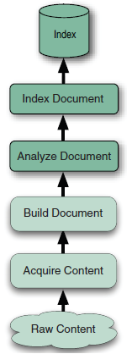
Indexing

Slide 18
Indexing Basics
Solr is able to achieve fast search responses because, instead of searching the text directly, it searches an index instead.
  Solr stores this index in a directory called index in the data directory
    ${instanceDir}/data/index
    ${dataDir}/index
http://www.solrtutorial.com/basic-solr-concepts.html

Slide 19
Defining Fields
Fields are defined in the fields element of schema.xml
The field type options serve as defaults
Fields can have the same options as field types
http://docs.lucidworks.com/display/solr/Defining+Fields

Slide 20
Defining Fields (cont.)
indexed
  If true, the value of the field can be used in queries to retrieve matching documents
stored
  If true, the actual value of the field can be retrieved by queries
http://docs.lucidworks.com/display/solr/Defining+Fields

Slide 21
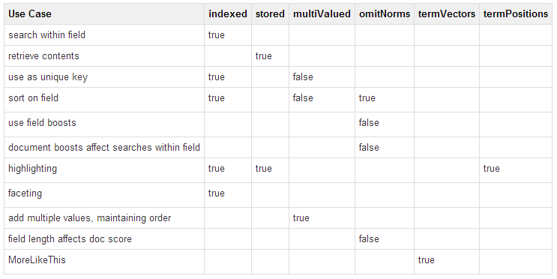
Defining Fields (cont.)
http://lucidworks.lucidimagination.com/display/solr/Field+Properties+by+Use+Case

Slide 22
Defining Fields (cont.)
copyField
  Interpret some document fields in more than one way
  <copyField source="cat" dest="text" maxChars="30000" />
dynamicField
  Like a regular field except it has a name with a wildcard in it
  <dynamicField name="*_i" type="int" indexed="true" stored="true"/>
http://docs.lucidworks.com/display/solr/Copying+Fields
http://docs.lucidworks.com/display/solr/Dynamic+Fields

Slide 23
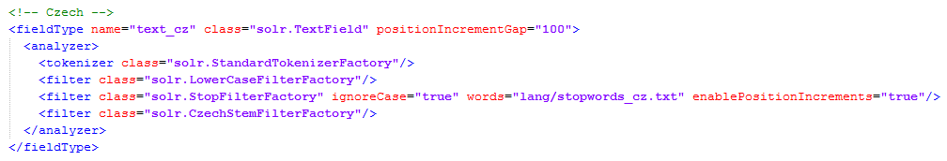
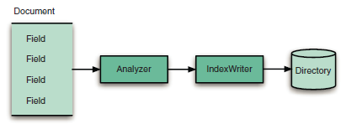
Defining Field Types
In normal usage, only fields of type solr.TextField will specify an analyzer
http://docs.lucidworks.com/pages/viewpage.action?pageId=14647687

Slide 24
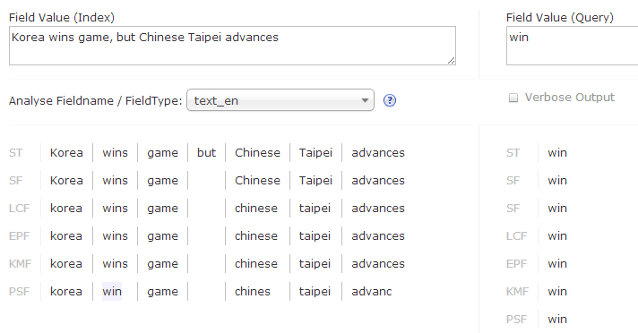
Field Analysis
ST: StandardTokenizerFactory
SF: StopFilterFactory / SynonymFilterFactory
LCF: LowerCaseFilterFactory
EPF: EnglishPossessiveFilterFactory
KMF: KeywordMarkerFilterFactory
PSF: PorterStemFilterFactory
Analysis process is used for both indexing and querying
Notes:
Korea wins game, but Chinese Taipei advances
http://docs.lucidworks.com/display/solr/Overview+of+Analyzers%2C+Tokenizers%2C+and+Filters
http://wiki.apache.org/solr/AnalyzersTokenizersTokenFilters

Slide 25
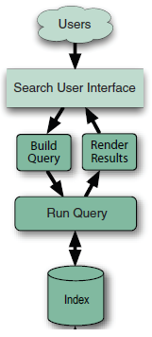
Searching

Slide 26
Searching Basics
http://localhost:8983/solr/select?q=video
  Hostame: localhost
  Port: 8983
  Application name: solr
  Request handler: select
  Query: q=video
http://docs.lucidworks.com/display/solr/Running+Solr

Slide 27
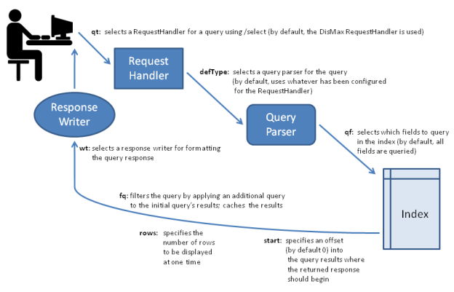
Search Flow
http://docs.lucidworks.com/display/solr/Overview+of+Searching+in+Solr

Slide 28
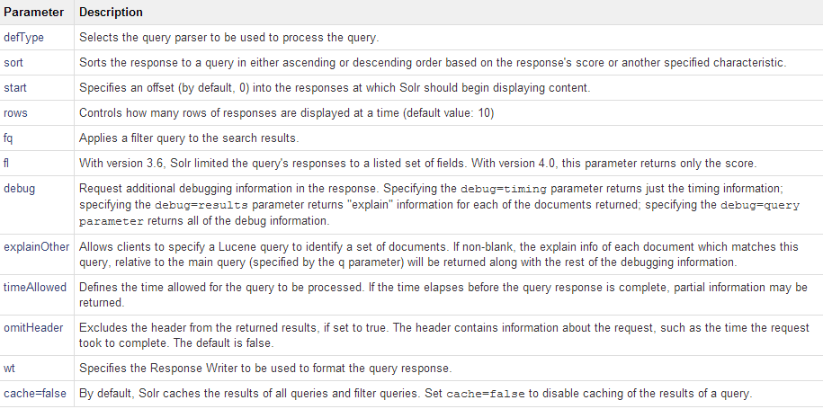
Common Query Parameters
http://docs.lucidworks.com/display/solr/Common+Query+Parameters

Slide 29
Parser-Specific Query Parameters
Different query parsers support different syntax
Three query parsers are supported in Solr
  Standard query parser
    Default
    Allows for greater precision in searches
    Less tolerant of syntax errors than the DisMax
  DisMax query parser
    Much more tolerant of errors
  Extended DisMax query parser
    Improved version of DisMax
http://docs.lucidworks.com/display/solr/Overview+of+Searching+in+Solr
Notes:
standard http://docs.lucidworks.com/display/solr/The+Standard+Query+Parser
DisMax http://docs.lucidworks.com/display/solr/The+DisMax+Query+Parser
Extended DisMax http://docs.lucidworks.com/display/solr/The+Extended+DisMax+Query+Parser

Slide 30
Query Examples
Query | Description
q=video &fl=id,name,price | Results only contain the ID, name, and price All fields are returned if not specified
q=name:black &fl=id,name,price | Searches for “black" in the name field only
q=price:[0 TO 400] &fl=id,name,price | Range query Finds every document whose price is between 0 and 400
q=price:[0 TO 400] &fl=id,name,price &facet=true&facet.field=cat | Faceted search
q=price:[0 TO 400] &fl=id,name,price &facet=true&facet.field=cat&fq=cat:software | Faceted search with filter query
http://docs.lucidworks.com/display/solr/Running+Solr

Slide 31
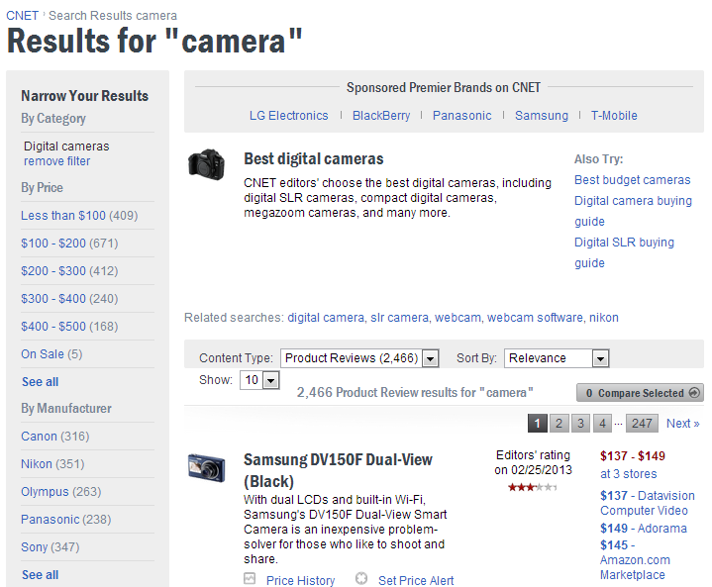
Faceted Search Example

Slide 32
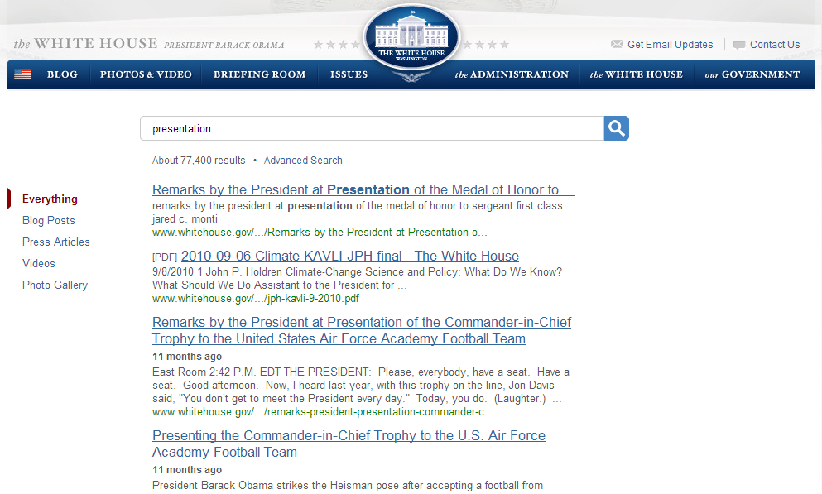
Highlighting Example

Slide 33
soLrCloud

Slide 34
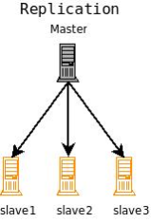
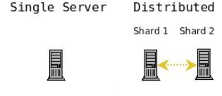
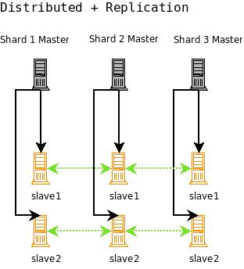
Way to SolrCloud
http://docs.lucidworks.com/display/solr/A+Quick+Overview

Slide 35
Terminologies
Name | Description
Collection | A set of documents
Partition | A subset of the entire document collection
Document | A group of fields and their values
Node | A JVM instance running Solr
Shard | A set of Nodes host the same Partition
Leader | Each shard has one node identified as its leader
Replica | A copy of a shard
http://docs.lucidworks.com/display/solr/SolrCloud+Glossary

Slide 36
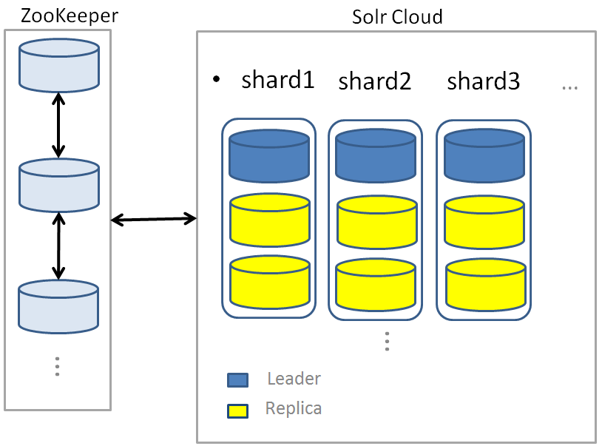
What is SolrCloud?

Slide 37
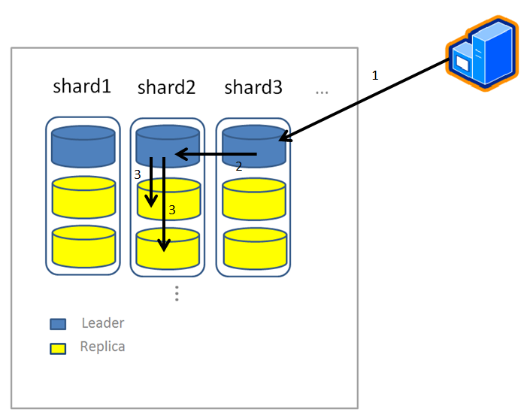
Indexing in SolrCloud

Slide 38
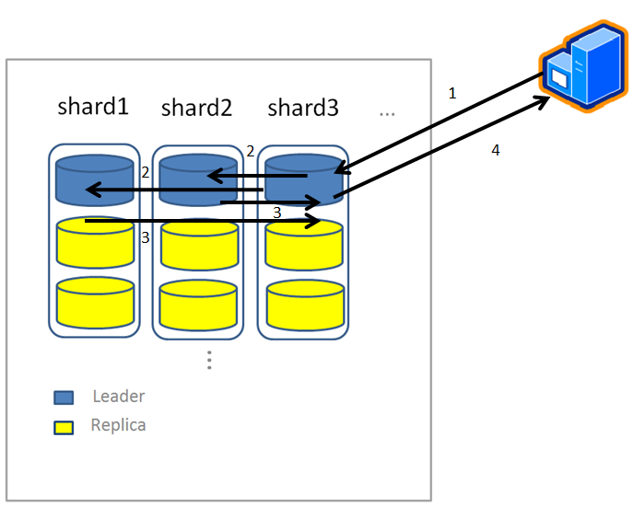
Searching in SolrCloud

Slide 39
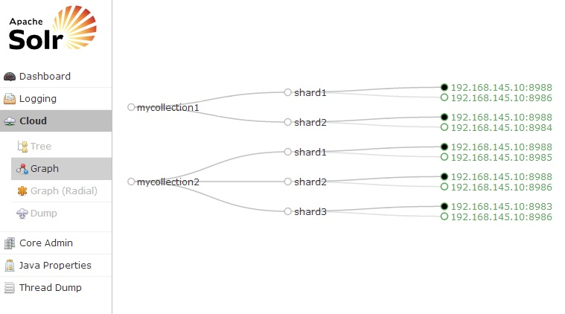
SolrCloud Example

Slide 40


