Slide 1
HBase 簡介 : 資料格式與運作架構
Hubert 范姜-亦思科技

Slide 2
Agenda
Story of HBase
Powered by HBase
Features of HBase
Infrastructure(Responsibility of Nodes)
Architecture
Take a Look !

Slide 3

Story of HBase
2003 “The Google File System”
2004 “MapReduce: Simplified Data Processing on Large Clusters”
2006 “Bigtable: A Distributed Storage System for Structured Data”

Slide 4
Features of HBase
Distributed
  分散存放
Versioned
  每一個Cell的資料都可以有多個版本存在
Key/Value Database
  Column-Oriented?

Slide 5
Features of HBase
Non-Relational
  沒有Primary Key, Foreign Key存在
Base on Hadoop
  架設在Hadoop檔案系統之上可以有比較好的效果
"NoSQL" Database
  不使用SQL存取資料，也不同於SQL存取資料庫的模式
Strictly Consistency

Slide 6





Members and Contributors

Slide 7




Powered by HBase
Notes:
Adobe : We are using HBase in several areas from social services to structured data and processing for internal use. We constantly write data to HBase and run mapreduce jobs to process then store it back to HBase or external systems.
Yahoo: to store document fingerprint for detecting near-duplications, We use this for querying duplicated documents with realtime traffic.
=> Hortonworks (thousands of nodes)
Facebook: Message

Slide 8

Hbase at Twitter
Data in Twitter
  HDFS
  Cassandra ( Created by Facebook )
  HBase
  FlockDB ( Created by Twitter )
    fault-tolerant graph database

Slide 9


Hbase at Facebook
Data in Facebook
  HDFS
  Cassandra ( Created by Facebook )
  HBase

Slide 10
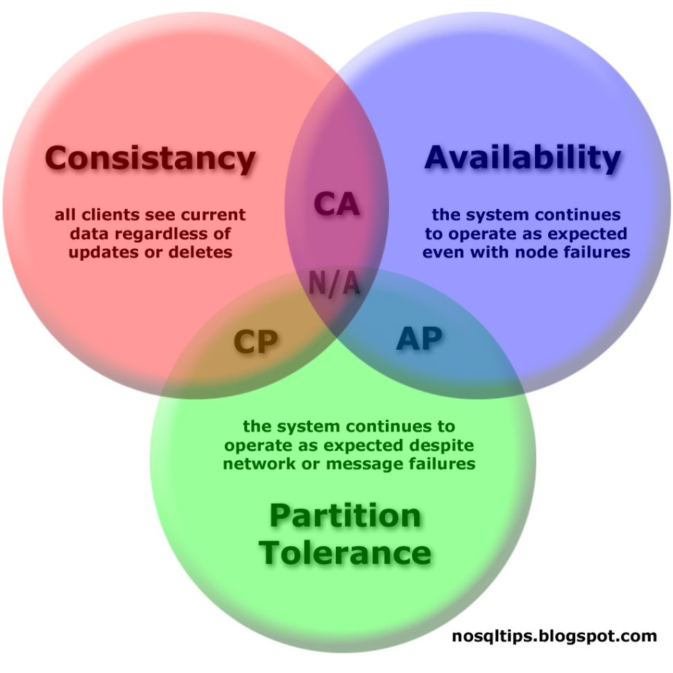
NoSQL Database的選擇
CAP理論
CA? AP?
Notes:
一致性(Consistency) (所有節點在同一時間具有相同的數據)
可用性(Availability) (保證每個請求不管成功或者失敗都有響應)
分隔容忍(Partition tolerance) (系統中任意信息的丟失或失敗不會影響系統的繼續運作)

Slide 11
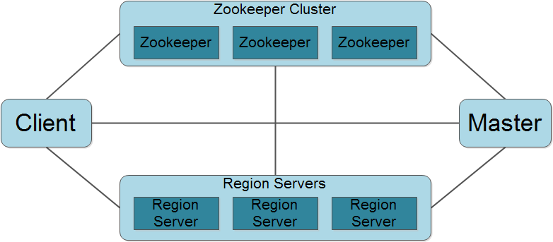
Responsibility of Nodes

Slide 12
Responsibility of Nodes
Client
  HBase的終端使用者，可以透過HBase Shell或HBase Client API連接到HBase Cluster。

Slide 13
Responsibility of Nodes
Master
  分派Region Server必須管理的Region範圍。
  負責Region Server的負載平衡（Load Balance）。
  偵測故障的Region Server並重新分配其上的Region由其他Region Server接手管理。
  HDFS上的垃圾文件回收。
  更新Table Schema。

Slide 14
Responsibility of Nodes
Region Server
  Region Server維護Master分配的Region，處理對所屬Region的IO請求。
  Region Server負責切分在運行過程中儲存空間超過門檻值的Region。

Slide 15
Responsibility of Nodes
Zookeeper：以Google的Chubby為藍本實現的開源軟體，是一個分散式系統的協調工具。
  選擇Master。
  儲存Region的Mapping資料。
  監控Region Server的狀態，即時通知Region server的啟動與斷線信息給Master。
  儲存HBase的Schema，包括有哪些Table，每個Table有哪些Column Family。

Slide 16
Responsibility of Nodes
n個,n>=1
ZooKeeper
ZooKeeper
Master
ZooKeeper
Master
Master
單數個
Region Server
Region Server
Region Server
Region Server
…….
Notes:
ZooKeeper
ZooKeeper is a centralized service for maintaining configuration information, naming, providing distributed synchronization, and providing group services.
Zookeeper Quorum中除了存儲了-ROOT-表的地址和HMaster的地址，HRegionServer也會把自己以Ephemeral方式註冊到Zookeeper中，使得HMaster可以隨時感知到各個HRegionServer的健康狀態。此外，Zookeeper也避免了HMaster的單點問題，見下文描述, Watcher
HMaster沒有單點問題，HBase中可以啟動多個HMaster，通過Zookeeper的Master Election機制保證總有一個Master運行，HMaster在功能上主要負責Table和Region的管理工作：
1. 管理用戶對Table的增、刪、改、查操作
2. 管理HRegionServer的負載均衡，調整Region分佈
3. 在Region Split後，負責新Region的分配
4. 在HRegionServer停機後，負責失效HRegionServer 上的Regions遷移

Slide 17
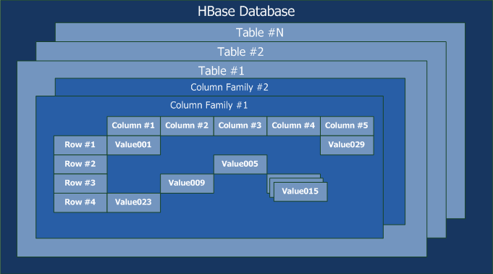
Architecture - Data Structure

Slide 18
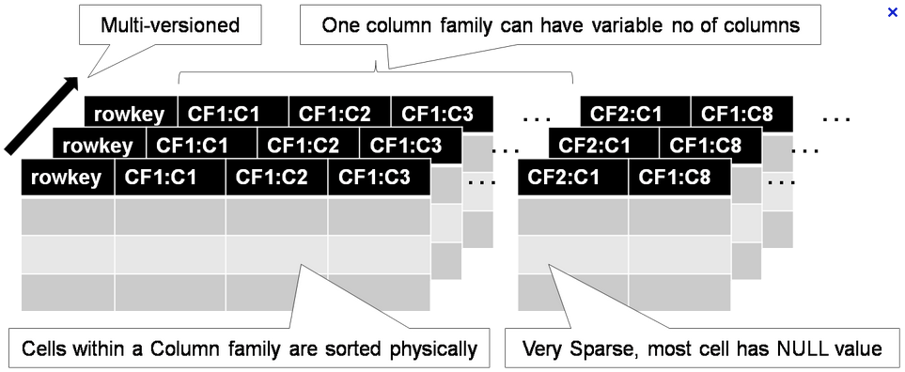
Data Format

Slide 19
RDB Data Format
Lot_ID | Date | Facility | Operator
A000001.00 | 2012/06/15 | BSET | Andy
A000002.00 | 2012/06/15 | DSET | Mike
A000003.00 | 2012/06/15 | BSET | Hubert

Slide 20
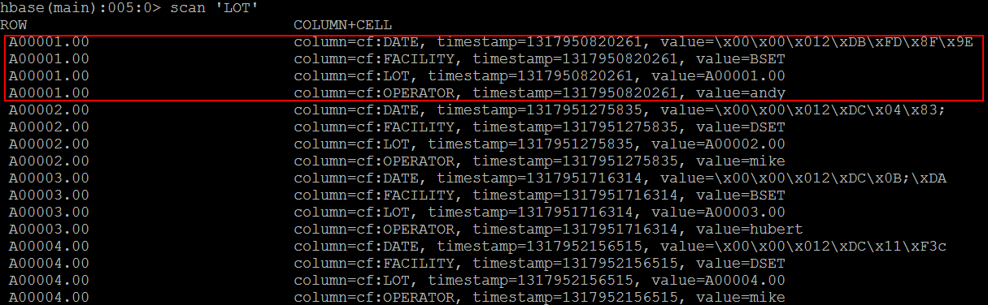
HBase Data format

Slide 21
Region
Table (HBase Table)
  Region (Regions for the Table)
    Store (Store per ColumnFamily for each Region for the table)
      MemStore ( MemStore for each Store for each Region for the table)
      StoreFile (StoreFiles for each Store for each Region for the table)
        Block (Blocks within a StoreFile within a Store for each Region for the table)

Slide 22
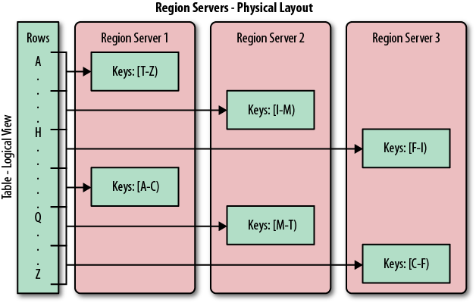
Region
Region

Slide 23
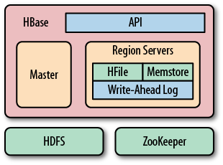
Memstore Flush
Flushing the memstore to disk causes a HFile

Slide 24
HTable
Region
Region
Region
Region
Region
Region
Store
Store
Store File
Memstore
Store File
Memstore
Store File
Store File
Store File
Store File
HFile
HFile
Store File
Store File
HFile
HFile
HFile
HFile
HFile
HFile
Split/Compaction
一個CF一個Store
Block
Block
Block
Block
Block
Block
Block
Block
一次flush產生一個HFile

Slide 25
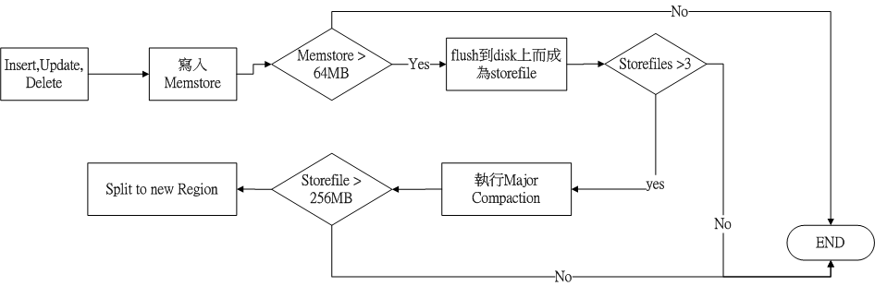
HFile
hbase中hfile的默認最大值(hbase.hregion.max.filesize)是256MB

Slide 26
Compaction
合併多個HFile => one Hfile
Two Types
  Minor Compaction (部分文件合併)
  Major Compaction (完整文件合併)
    刪除過期&已刪除的data
    一個store只會有一個storefile

Slide 27
Compaction的好處
減少Hfile的個數
提高Performance
刪除過期&已刪除的data

Slide 28
Performance Notes
hbase.hregion.max.filesize = ?
  File size 比較小時
    易發生Split (Split會將region offline)
  File size比較大時
    Split發生機會低
    Compaction發生機會高(io成本比較高)

Slide 29
Performance Notes
Table中CF與Qualifier的差別
  以讀來思考
    All rows => CF ?
    All rows => Qualifier (one CF) ?
    CF的優勢=> 同一個CF會存在同一個Hfile
    一次scan會取出同一個rowkey下整個CF的資料(CF可指定)

Slide 30
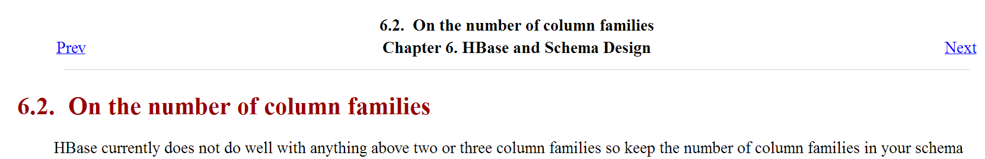
Performance Notes
Table中CF與Qualifier的差別
  以寫來思考
    CF不宜過多 =>易造成集體Flush & Compaction(compaction storms)
    Reference: http://hbase.apache.org/book/number.of.cfs.html
Notes:
Flush and Compaction是以Region為單位
過多的CF => 不同的CF(Store Instance) 都在同一個Region下面,而每個

Slide 31
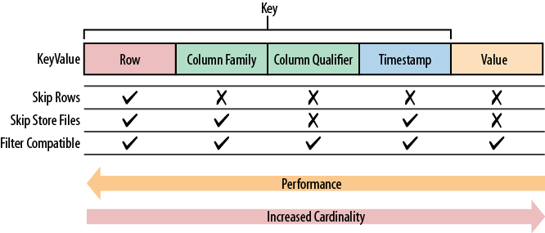
Performance of Keys

Slide 32
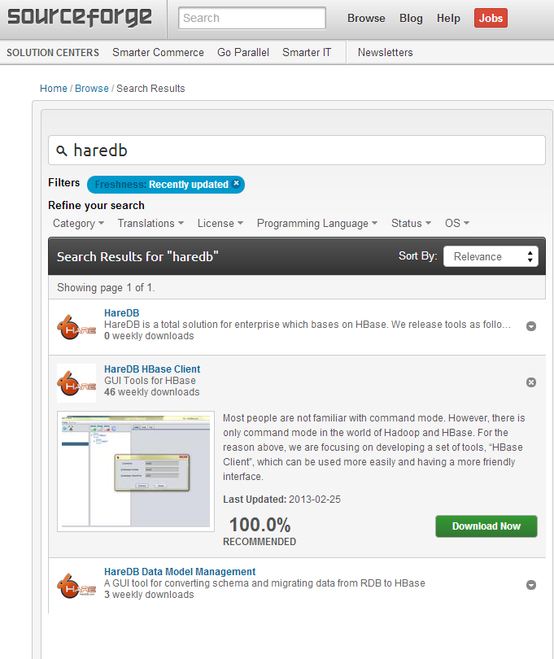
Take a look!
HBase Client

