Slide 1
微軟雲端運算的策略與產品藍圖
李匡正 Tom Lee
開發工具暨平台推廣處
台灣微軟
Feb 2010

Slide 2

各種不同形式的雲端平台
由 Yankee Group, 2008 報告修改
Storage as a Service
Infrastructure as a Service Software
Platform as a Service
Software as a Service
Management &
Provisioning
Management &
Provisioning
Management &
Provisioning
Management &
Provisioning
Configurators /
APIs
Application
Software
Virtualization
Virtualization
Virtual Platform Software
Virtual Platform Software
Disks
Servers
Disks
Server & Disks
Microsoft SQL Azure
Amazon Simple Storage Service
Google Base
MS Windows Azure VM Role
Amazon Elastic Compute Cloud Service
Sun Network.com
HP Flexible CS
IBM Blue Cloud
MS Windows Azure
Google App Eng
Salesforce Force.com
Oracle SaaS Platform
MS Dynamic CRM Online
MS Exchange Online
MS SharePoint Online
MS Business Productive Online Services
Salesforce SFA
Google Apps

Slide 3


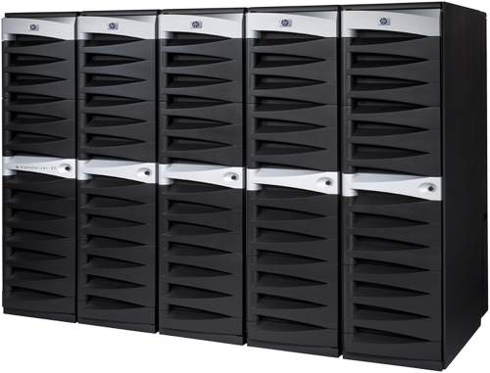
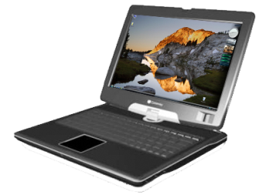


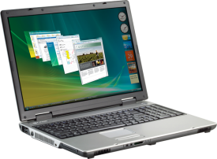
持有軟體與雲端服務各有優劣
資訊安全與隱私權保護
易於依需要強化程式
看得到、摸得到
資料掌控度
遍佈全球
容易取得
配合商業上的彈性
易於佈建、維護

Slide 4
微軟策略: 給客戶"選擇"的權力
軟體
同時提供最好的選擇
  使用者來決定
    IT 選擇最適當的方案
+
服務
延伸現有的工具與平台到雲端
  沿續好的使用經驗到多種裝置

Slide 5
雲端平台類型與長尾理論
IBM Blue Cloud
EMC/VMWare vCloud
Microsoft Windows Server HyperV / Dynamic Datacenter Toolkit
Microsoft Windows Azure Platform
SalesForce force.com
Google Apps Engine
Amazon Elastic Compute Cloud Service

Slide 6





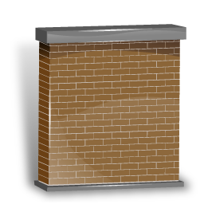












Microsoft Cloud Computing 全貌
Private
Public
Software as a Service
(SaaS)
IT as a Service
Platform as a Service
(PaaS)
Infrastructure as a Service
(IaaS)
|
Dynamic Data Center Toolkit
For Enterprises
|
Dynamic Data Center Toolkit
For Hosters

Slide 7
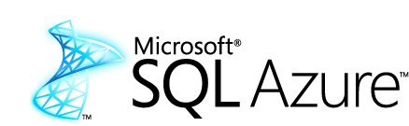


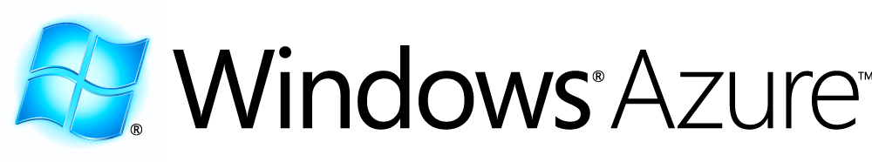
Windows Azure Platform
Windows Azure™ Platform

Slide 8
Windows Azure Platform
Windows Azure™ Platform

Slide 9

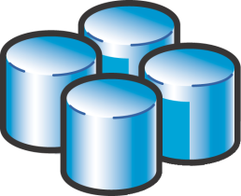



Windows Azure
佈署至雲端 Windows Azure
單機環境開發除錯測試
全球用戶使用

Slide 10
Windows Azure
微軟於 2008 年 10月28日 PDC 2008 所宣布的雲端作業系統，2010 年1月開始營運
針對公用運算 (Utility Computing) 所設計
主要功能 :
  服務管理 Service management
  運算 Compute
  資料儲存 Storage
  與傳統微軟之軟體(on-premise)開發一致的經驗

Slide 11
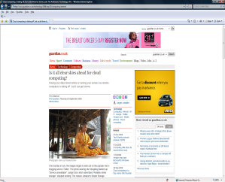
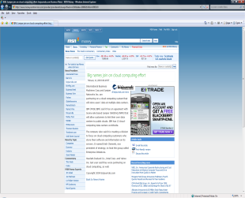
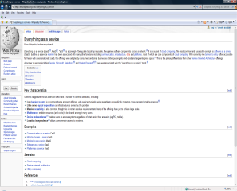

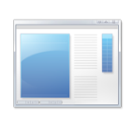



Windows Azure 應用系統實體配置
Internet
負載平衡LB
微軟 Windows Azure 資料中心
儲存區域 Storage
Worker Role
Queue
Web Role
(ASPX, WCF)
Tables
Blobs

Slide 12
Windows Azure Storage
具備高度延展能力
提供三種儲存型態:
  Blobs: 簡易之 階層式二進制資料
  Tables: entity-based storage (並非關聯式資料庫模型)
  Queues: 以訊息為基礎之通訊方式
  Drives (未來): 提供可延展之檔案系統
存取方式:
  僅可透過 REST 為存取界面
  資料可提供
    Windows Azure 應用程式使用
    其他 on-premises 應用程式使用

Slide 13
Windows Azure Storage table 儲存結構
Table
Table
Table
. . .
Entity
Entity
Entity
. . .
Storage Accounts
Property
Property
Property
Name
Type
Value

Slide 14


Windows Azure Platform
Windows Azure™ Platform

Slide 15



Microsoft SQL Azure
延伸 Microsoft SQL 資料平台至雲端
Windows Azure Platform 提供關連式資料庫服務
運用現有 Microsoft SQL Server 為基礎，高度相容於現有資料存取技術與工具
資料量限制至 10 G Bytes，具備高可用度
Database
Data Sync
Reporting
Data Mining
Reference Data
ETL

Slide 16
Microsoft SQL Azure
Application
Browser
Application
Application
ODBC, OLEDB, ADO.Net PHP, Ruby, …
REST Client
SQL Client*
Cloud
HTTP+REST
HTTP
TDS
Windows Azure
Worker Role
Web Role
SQL Client*
Data Center
TDS + TSQL Model
SQL Azure
* Client access enabled using TDS for ODBC,
ADO.Net, OLEDB, PHP-SQL, Ruby, …

Slide 17
Windows Azure Platform
Windows Azure™ Platform

Slide 18
Windows Azure Platform AppFabric
  .NET Service Bus
    支援 REST 跨越防火牆之 Internet Service Bus。 提供
      Eventing:
        主動觸發通知應用系統/設備
      Service Remoting:
        顧及資料傳輸安全前提下，讓企業內部應用系統提供服務給雲端應用系統叫用
      Tunneling:
        應用程式對應用程式之間通訊，可穿越 NAT 與防火牆
  .NET Access Control Service
    邦聯式 (federated) 身分認證與權限管理機制
      能夠整合 Microsoft ADFS version 2
      支援 Web Resource Authorization Protocol (WRAP) 與 Simple Web Token (SWT)

Slide 19
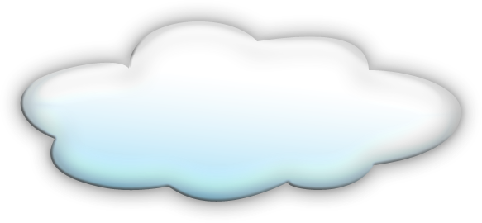


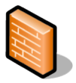
Windows Azure Platform AppFabric
.NET Service Bus
Service
Service Bus
Service
Application
.NET Access Control Service
Services
Access
Control
Application
Service Bus

Slide 20

Windows Azure Platform
Windows Azure™ Platform

Slide 21
新推出資料即服務 “Dallas”
資料內容轉介服務 (Content Brokerage)
  能夠尋找,瀏覽與使用各種類型之資料內容
    二進制之資料內容
    結構化之資料內容
    即時 web services 所提供之內容
  融入全球內容供應者生態系統
運用 Windows Azure 與 SQL Azure 技術建立而成

Slide 22

Live Services
微軟所提供之網路基礎服務，針對一般消費性市場，提供各式應用與開發介面
Live Services
Mesh Services
User
Devices
Applications
Synchronization
Identity
Directory
Storage
Comms & Presence
Search & Geospatial

Slide 23
雲端典型應用情境 (1)
Running an on-premises app in the cloud
  Example: An enterprise moving a line-of-business app to the cloud
Creating a small-to-medium Web app
  Example: A Web ISV creating a moderately popular application
  Example: An enterprise application used by a firm’s employees
Creating a large Web application
  Example: An ISV creating the next Facebook
  Example: A large bank creating a customer-facing app

Slide 24
雲端典型應用情境 (2)
Creating a parallel processing application
  Example: The New York Times converting its article database to searchable PDFs
Creating a Web application with back-end processing
  Example: An ISV creating the next YouTube
Storing blob data
  Example: An enterprise archiving data
  Example: A hosted Web app storing large amounts of video

Slide 25
目前主要雲端平台比較
Web Apps with Back-end Processing
On-Premises Apps
Small-to-Medium Web Apps
Parallel Processing Apps
Large Web Apps
Store Blob Data
GoGrid, Flexiscale, Others
x
x
Amazon Web Services
x
x
x
x
x
x
Windows Azure 2009 July CTP
x
x
x
x
x
Google AppEngine
x
Salesforce.com Force Platform
x

Slide 26

Windows Azure 服務品質
Storage service will be available/ reachable (connectivity)
Your storage requests will
be processed successfully
Service Bus endpoint will have external connectivity
Message operation requests will be processed successfully
Compute connectivity
Role instance monitoring and restart
Database availability
Storage availability
Service
availability
Your service is connected and reachable via web
Internet facing roleswill have external connectivity
All running
roles will be continuously monitored
If role is unhealthy, we will detect and initiate corrective state
Database is connected to the internet gateway
Availability monitoring every 5-minute interval
Automated Systems Management
>99.95%
>99.9%
>99.9%
>99.9%

Slide 27



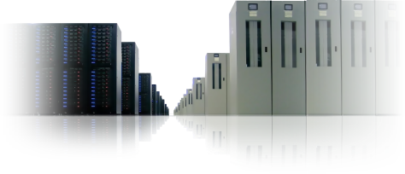
高安全性的資料中心
經由穩固和成熟的法規遵循管理方案，來管理 安全性、隱私性和高可用性。
重點功能
資料中心跨地理區域備援
N+1 式架構設計
9 層資料安全保護
透過 SSL 安全存取
遵循 ITIL/MOF 維運規範
24x7x365 支援服務
99.9% 不停機 SLA
Filtering Routers
Firewalls
Intrusion Detection System
System Level Security
Application Authentication
Application Level Counter-measures
Virus Scanning
Separate Data Networks
Authentication to Data
Notes:
One area that we are very conscious of is the importance of security and availability. We want to ensure that customer feel confident that we are protecting their data and the service is highly available. Our service runs on a set of datacenters that are managed by a centralized organization within Microsoft that are making major investments in datacenter spaces and capabilities. We deploy our service on the latest hardware and network equipments in a N+1 architecture to enable failover capabilities as well as saving your data in a separate geo-redundant location. We are regularly tested by a third party CyberTrust to ensure our infrastructure is secure against attacks. We follow ITIL/MOF in our operational processes and we are in the process of getting our SAS-70 audit to ensure we have strictest level of control.
Above all, we will provide 24x7 IT Pro support and our service availability is backed by a 99.9% uptime SLA.
Physical security is but one part it. When you look, we ultimately need to make sure that since we are providing an internet based service, we are protecting customer’s data in a variety of ways. We look at this as multiple layers of protection. Microsoft is actually providing 9 layers of logical security for our customers and their service and data.
Filtering Routers: these are implemented to protect against any traffic we do not see as well constructed. One of the great benefits of providing a focused service like BPOS is we actually set up the routers to protect against any form of malform data. We block at an aggregate at the edge.
Firewalls are set up as deny all.
Behind the firewalls we have an Intrusion Detection System. We have a very sophisticated correlation engine for any intrusion alert that we’re tracking 24 hours a day.
Below the IDS, we have a level System Level Security. When you look, the service operations organization actually has broad based, dual factor authentication. This means each individual within a support and service operations team have either some sort of secure ID card or a RSH secure ID token that is coupled with their role. Each individual must have a user ID and password and must apply a pin with their secure ID token. Based on the role they have, we grant access per individuals to the service.
Application Authentication: when you get below the System Level Security, the customers actually have application level authentication. We have a very sophisticated mechanism by which we provide access to data. The structure of the service provides users access to only those capabilities they are designed to have.
In the reseller model where a partner is actually providing the service to the customer, they have a level of application authentication that sits over top of that which the customers have. So we’re able to provide a very rich set of security protocols for our customers, as it relates to authentication to the different services.
Microsoft, as most people know, has a good history as relates to security and trustworthy computing. Our services are actually designed to make sure that we apply those security methods not only to the software, but we also treat that software as a service. So when we do our threat walling and follow the Windows initiative, we’re thinking about our applications as if they are delivered through the Internet. We apply a significant level of counter measures, such as buffer overflows and SQL injection, we make sure that the applications we’re running are sandboxed so you can’t activate elevated levels of security or access a higher level of authentication when you’re actually doing work within our application.
Virus Scanning is provided for multiple set of capabilities. We actually virus scan at all over our server levels, we have in place intrusion detection at the host and we’re scanning our content via Microsoft ForeFront.
Then we have Separate Data Networks. When you look inside the data center, So what when we do our threat walling and follow the Windows initiative. These are implemented in a form that breaks it apart. For example, the data bases are on a separate sub net then from the actual content server or something that is an internet facing device.
When you look, even though we are an internet facing service, very few devices have direct access to the internet. All of the servers are on some form of non-routable subnet space.
Finally you are authenticated into the data. The data itself is never stored on the physical servers, we run separate data networks and the data is stored on dedicated storage devices. So when you look at the content, the content is actually being sent from dedicated storage devices, which allows us to provide significant levels of backup as well.

Slide 28


Windows Azure Platform 使用計價
http://www.microsoft.com/azure/faq.mspx#pricing
  運算 = $0.12/小時
  儲存 = $0.15/GB/月
  儲存交易量 = $0.01/10K
  頻寬 = $0.30 in / $0.45 out /GB (Asia)
  Web 版 (最多到1GB 關聯式資料庫) = $9.99/月
  企業版 (最多到10G關聯式資料庫) = $99.99/月
  頻寬 = $0.30 in / $0.45 out /GB (Asia)
  訊息= $0.15/100K (Service Bus messages & AC Tokens)
  頻寬 = $0.30 in / $0.45 out /GB (Asia)

Slide 29
相關資源
Windows Azure Platform 開發人員中心
  http://msdn.microsoft.com/zh-tw/azure/default.aspx
Windows Azure Platform SDK 下載與申請 Token
  http://www.microsoft.com/windowsazure/getstarted/
Windows Azure Platform Training Kit (OCT 2009 and NOV 2009 Update)
  http://www.microsoft.com/downLoads/details.aspx?familyid=413E88F8-5966-4A83-B309-53B7B77EDF78&displaylang=en
Windows Azure Developers Forum
  http://social.msdn.microsoft.com/Forums/en-US/category/azure

Slide 30

© 2009 Microsoft Corporation. All rights reserved. Microsoft, Windows, Windows Vista and other product names are or may be registered trademarks and/or trademarks in the U.S. and/or other countries.
The information herein is for informational purposes only and represents the current view of Microsoft Corporation as of the date of this presentation. Because Microsoft must respond to changing market conditions, it should not be interpreted to be a commitment on the part of Microsoft, and Microsoft cannot guarantee the accuracy of any information provided after the date of this presentation. MICROSOFT MAKES NO WARRANTIES, EXPRESS, IMPLIED OR STATUTORY, AS TO THE INFORMATION IN THIS PRESENTATION.

Slide 31
Windows Azure 架構 – 系統模塊
Developer Tools
Programming Model
Service Management
Storage Abstractions: Blobs, Tables, …
Load Balanced Partitions
Replicated Data Store
Service Model Processing; Service Health Model
VM Image Deployment; Network Programming; VM Allocation
Microsoft Global Datacenters
Equivalence to
Apache Hadoop

