Slide 1
The Anatomy of
Cloud Computing
Chao-Tung Yang 楊朝棟
Department of Computer Science
Tunghai University, Taichung, 40704, Taiwan R.O.C.
ctyang@thu.edu.tw
http://web.thu.edu.tw/ctyang/

Slide 2
Outline
Infrastructure
Software
Services
Applications
Summary

Slide 3
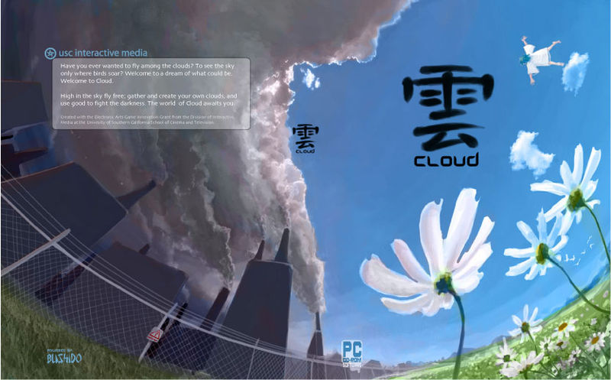
Cloud

Slide 4
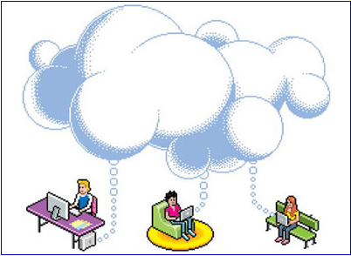
Why we use cloud computing?

Slide 5
Why we use cloud computing?
Case 1:
Write a file
Save
Computer down, file is lost
Files are always stored in cloud, never lost

Slide 6
What is cloud and cloud computing?
Cloud
Demand resources or services over Internet
scale and reliability of a data center.

Slide 7
What is cloud and cloud computing?
Cloud computing is a style of computing in which dynamically scalable and often virtualized resources are provided as a serve over the Internet.
Users need not have knowledge of, expertise in, or control over the technology infrastructure in the "cloud" that supports them.

Slide 8
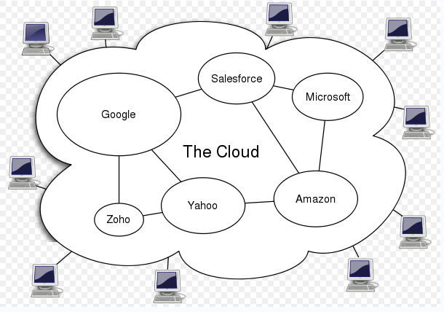
The architecture of cloud computing system

Slide 9
Characteristics of cloud computing
Virtual.
software, databases, Web servers, operating systems, storage and networking as virtual servers.
On demand.
add and subtract processors, memory, network bandwidth, storage.

Slide 10
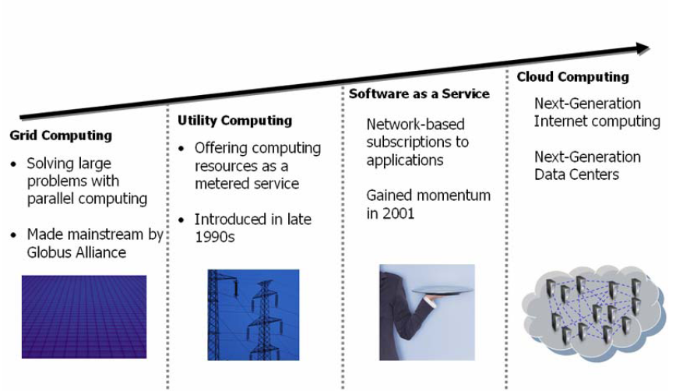
Cloud computing and other computing techniques

Slide 11
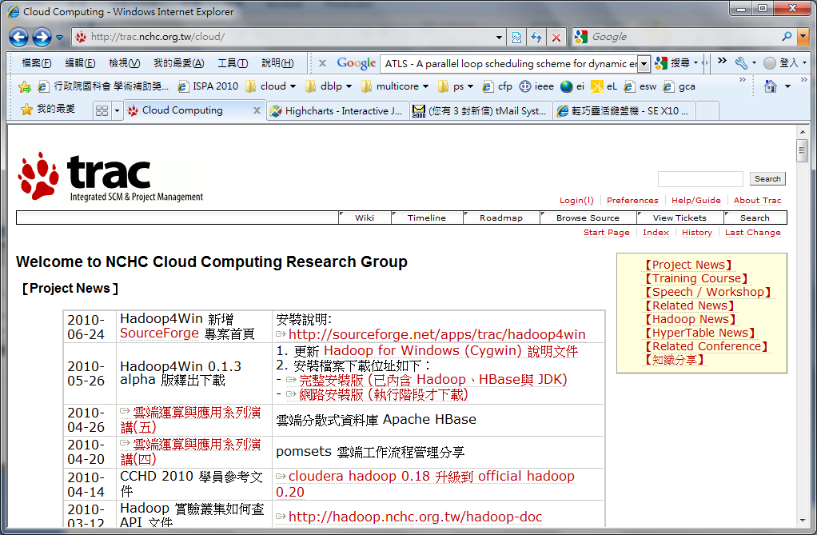
http://trac.nchc.org.tw/cloud/

Slide 12
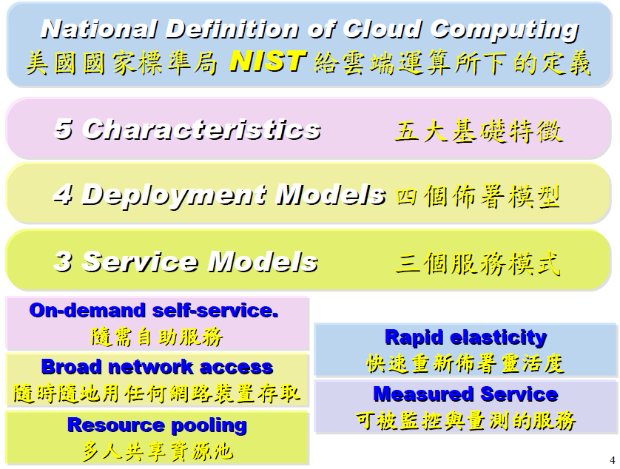

Slide 13
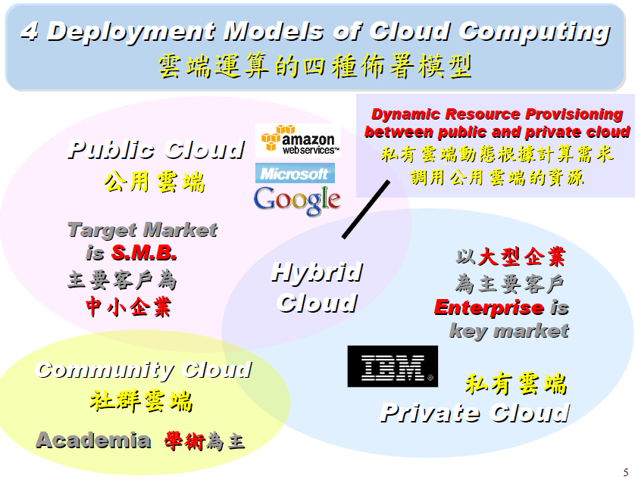

Slide 14
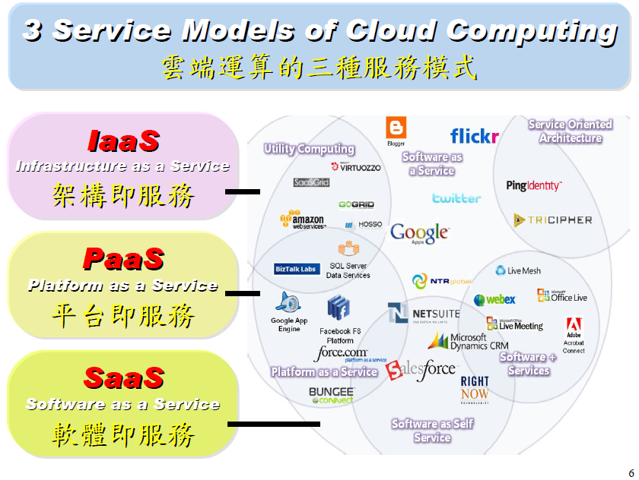

Slide 15
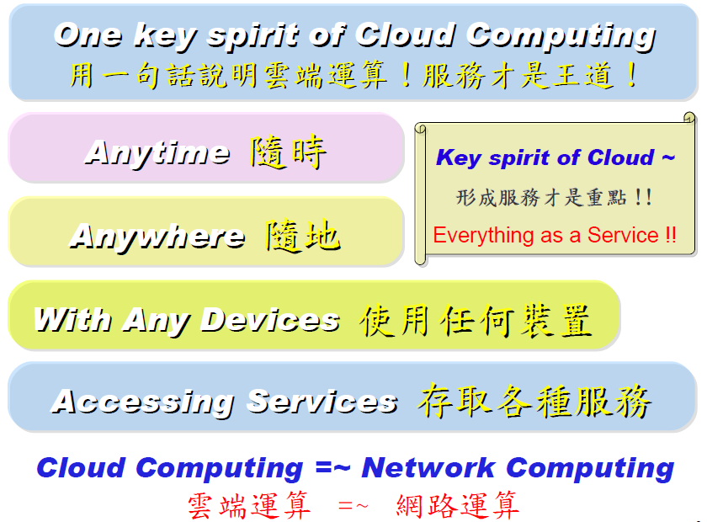

Slide 16
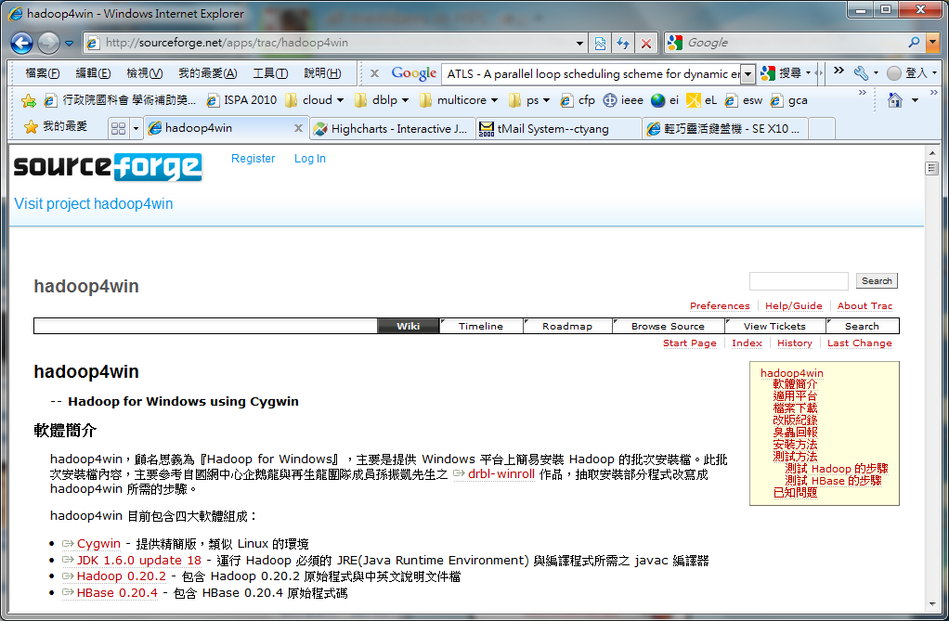
http://sourceforge.net/apps/trac/hadoop4win

Slide 17
Outline
Infrastructure
Software
Services
Applications
Summary

Slide 18
Infrastructure
Introduction to Cloud Computing
Virtualization and Cloud Computing
Infrastructure as a Service

Slide 19
Introduction to Cloud Computing
Cloud Computing means
  Outsourced
  Pay-as-you-go
  On-Demand
  Somewhere in the internet
  …etc.
Notes:
It looks like pretty soon all computing will be called cloud computing, just because the cloud is “in.” Fortunately most computer savvy folks actually have a pretty good idea of what the term ‘cloud computing’ means: outsourced, pay-as-you-go, on-demand, somewhere in the internet, etc. What is still confusing to many is how the different offerings compare from Amazon Web Services to Google App Engine and Force.com. I recently heard a characterization of three different levels of clouds which really helps put the various offerings into perspective. Here’s my rephrasing:

Slide 20
Introduction to Cloud Computing (cont.)
Cloud Computing in three levels
Application in the cloud
  This is what almost everyone has already used in the form of Gmail , Yahoo mail, wordpress.com, etc.
Platform in the cloud
  Developers write their application to a more or less open specification and then upload their code into the cloud where the app is run magically somewhere.
Notes:
Applications in the cloud: this is what almost everyone has already used in the form of gmail, yahoo mail, wordpress.com (hosting this blog), the rest of google apps, the various search engines, wikipedia, encyclopedia britannica, etc.
Some company hosts an application in the internet that many users sign-up for and use without any concern about where, how, by whom the compute cycles and storage bits are provided. The service being sold (or offered in ad-sponsored form) is a complete end-user application.
To me all this is SaaS, Software as a Service, looking to join the ‘cloud’ craze.

Slide 21
Introduction to Cloud Computing (cont.)
Infrastructure in the cloud
  Developers and system administrators obtain general compute, storage, queuing, and other resources and run their applications with the fewest limitations.
  This is the post powerful type of cloud in that virtually any application and any configuration.
Notes:
Infrastructure in the cloud: this is the most general offering that Amazon has pioneered and where RightScale offers its management platform. Developers and system administrators obtain general compute, storage, queueing, and other resources and run their applications with the fewest limitations. This is the most powerful type of cloud in that virtually any application and any configuration that is fit for the internet can be mapped to this type of service. Of course it also requires more work on the part of the buyer, which is where RightScale comes in to help with set-up and automation.

Slide 22
Introduction to Cloud Computing (cont.)
Cloud Computing in five layers (1/3)
  Client:
  A cloud client consists of computer hardware and/or software that relies on cloud computing for application delivery. Ex., PC, NB, mobile phones.
  Application:
  Cloud application services or "Software as a Service (SaaS)" deliver software as a service over the Internet, eliminating the need to install and run the application on the customer's own computers and simplifying maintenance and support.
Notes:
A cloud client consists of computer hardware and/or computer software that relies on cloud computing for application delivery, or that is specifically designed for delivery of cloud services and that, in either case, is essentially useless without it. Examples include some computers, phones and other devices, operating systems and browsers.
Cloud application services or "Software as a Service (SaaS)" deliver software as a service over the Internet, eliminating the need to install and run the application on the customer's own computers and simplifying maintenance and support. Key characteristics include:^{[43]}
Network-based access to, and management of, commercially available (i.e., not custom) software
Activities that are managed from central locations rather than at each customer's site, enabling customers to access applications remotely via the Web
Application delivery that typically is closer to a one-to-many model (single instance, multi-tenant architecture) than to a one-to-one model, including architecture, pricing, partnering, and management characteristics
Centralized feature updating, which obviates the need for downloadable patches and upgrades.

Slide 23
Introduction to Cloud Computing (cont.)
Cloud Computing in five layers (2/3)
  Platform:
  Platform as a Service (PaaS) deliver a computing platform and/or solution stack as a service, often consuming cloud infrastructure and sustaining cloud applications.
  Infrastructure:
  Infrastructure as a Service (IaaS) delivers computer infrastructure, typically a platform virtualization environment as a service.
Notes:
Cloud platform services or "Platform as a Service (PaaS)" deliver a computing platform and/or solution stack as a service, often consuming cloud infrastructure and sustaining cloud applications.^{[44]} It facilitates deployment of applications without the cost and complexity of buying and managing the underlying hardware and software layers.
Cloud infrastructure services or "Infrastructure as a Service (IaaS)" delivers computer infrastructure, typically a platform virtualization environment as a service. Rather than purchasing servers, software, data center space or network equipment, clients instead buy those resources as a fully outsourced service. The service is typically billed on a utility computing basis and amount of resources consumed (and therefore the cost) will typically reflect the level of activity. It is an evolution of virtual private server offerings.

Slide 24
Introduction to Cloud Computing (cont.)
Cloud Computing in five layers (3/3)
  Server
  The servers layer consists of computer hardware and/or computer software products that are specifically designed for the delivery of cloud services, including multi-core processors, cloud-specific operating systems and combined offerings.
Notes:
The servers layer consists of computer hardware and/or computer software products that are specifically designed for the delivery of cloud services, including multi-core processors, cloud-specific operating systems and combined offerings.

Slide 25
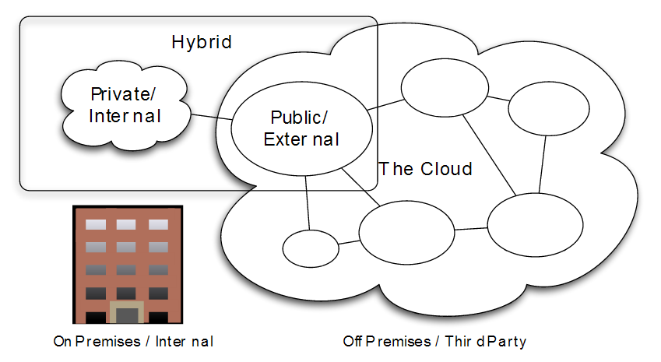
Introduction to Cloud Computing (cont.)
Deployment models
  Public cloud
  Community cloud
  Private cloud
  Hybrid cloud
Notes:
The servers layer consists of computer hardware and/or computer software products that are specifically designed for the delivery of cloud services, including multi-core processors, cloud-specific operating systems and combined offerings.

Slide 26
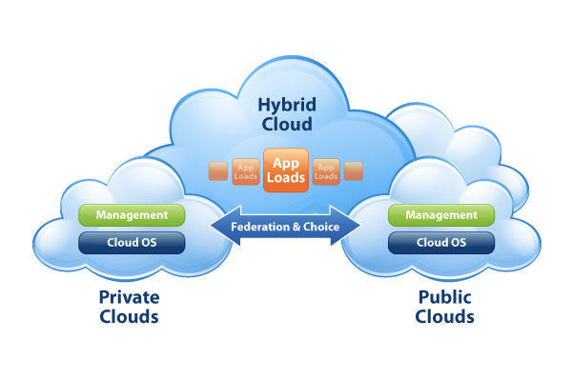
Introduction to Cloud Computing (cont.)
Deployment models
  Public cloud
    whereby resources are dynamically provisioned on a fine-grained, self-service basis over the Internet, via web applications/web services, from an off-site third-party provider who shares resources and bills on a fine-grained utility computing basis.
  Community cloud
  Hybrid cloud
  Private cloud
Notes:
Public cloud or external cloud describes cloud computing in the traditional mainstream sense, whereby resources are dynamically provisioned on a fine-grained, self-service basis over the Internet, via web applications/web services, from an off-site third-party provider who shares resources and bills on a fine-grained utility computing basis.

Slide 27
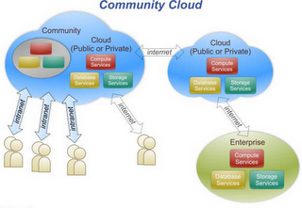
Introduction to Cloud Computing
Deployment models
  Public cloud
  Community cloud
    may be established where several organizations have similar requirements and seek to share infrastructure so as to realize some of the benefits of cloud computing.
    With the costs spread over fewer users than a public cloud (but more than a single tenant) this option is more expensive but may offer a higher level of privacy, security and/or policy compliance.
  Hybrid cloud
  Private cloud
Notes:
A community cloud may be established where several organizations have similar requirements and seek to share infrastructure so as to realize some of the benefits of cloud computing. With the costs spread over fewer users than a public cloud (but more than a single tenant) this option is more expensive but may offer a higher level of privacy, security and/or policy compliance. Examples of community cloud include Google's "Gov Cloud".

Slide 28
Introduction to Cloud Computing (cont.)
Deployment models
  Public cloud
  Community cloud
  Hybrid cloud
    environment consisting of multiple internal and/or external providers
    By integrating multiple cloud services users may be able to ease the transition to public cloud services
  Private cloud
Notes:
A hybrid cloud environment consisting of multiple internal and/or external providers^{[52]} "will be typical for most enterprises".^{[53]} By integrating multiple cloud services users may be able to ease the transition to public cloudservices while avoiding issues such as PCI compliance.^{[54]}
Another perspective on deploying a web application in the cloud is using Hybrid Web Hosting, where the hosting infrastructure is a mix between Cloud Hosting for the web server, and Managed dedicated server for the database server.

Slide 29
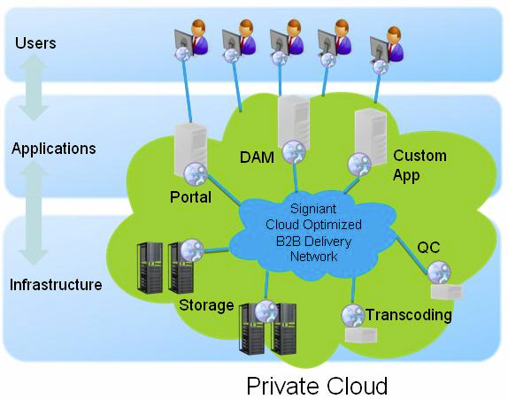
Introduction to Cloud Computing (cont.)
Deployment models
  Public cloud
  Community cloud
  Hybrid cloud
  Private cloud
    The concept of a Private Computer Utility was first described by Douglas Parkhill in his 1966 book "The Challenge of the Computer Utility". The idea was based upon direct comparison with other industries (e.g. the electricity industry) and the extensive use of hybrid supply models to balance and mitigate risks.
    Private cloud and internal cloud have been described as neologisms, however the concepts itself pre-dates the term cloud by 40 years.
Notes:
The concept of a Private Computer Utility was first described by Douglas Parkhill in his 1966 book "The Challenge of the Computer Utility". The idea was based upon direct comparison with other industries (e.g. the electricity industry) and the extensive use of hybrid supply models to balance and mitigate risks.
Private cloud and internal cloud have been described as neologisms, however the concepts itself pre-dates the term cloud by 40 years. Even within modern utility industries, hybrid models still exist despite the formation of reasonably well functioning markets and the ability to combine multiple providers.

Slide 30
Virtualization and Cloud Computing
Virtualization:
  The ability to run multiple operating systems on a single physical system and share the underlying hardware resources*
Cloud Computing:
  “The provisioning of services in a timely (near on instant), on-demand manner, to allow the scaling up and down of resources”**
* VMware white paper, Virtualization Overview
** Alan Williamson, quoted in Cloud BootCamp March 2009

Slide 31
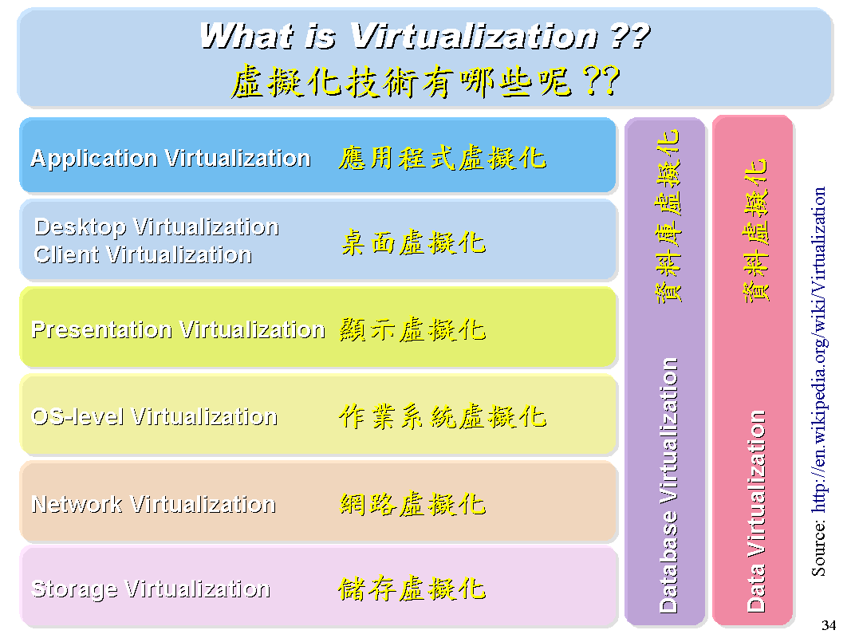
Virtualization and Cloud Computing (cont.)

Slide 32
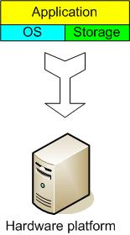
The Traditional Server Concept
Web Server
Windows
IIS
App Server
Linux
Glassfish
DB Server
Linux
MySQL
EMail
Windows
Exchange

Slide 33
And if something goes wrong ...
Web Server
Windows
IIS
App Server
DOWN!
DB Server
Linux
MySQL
EMail
Windows
Exchange

Slide 34
The Traditional Server Concept
System Administrators often talk about servers as a whole unit that includes the hardware, the OS, the storage, and the applications.
Servers are often referred to by their function i.e. the Exchange server, the SQL server, the File/ftp server, etc.
If the File server fills up, or the Exchange server becomes overtaxed, then the System Administrators must add in a new server.

Slide 35
The Traditional Server Concept (cont.)
Unless there are multiple servers, if a service experiences a hardware failure, then the service is down.
System Admins can implement clusters of servers to make them more fault tolerant. However, even clusters have limits on their scalability, and not all applications work in a clustered environment.

Slide 36
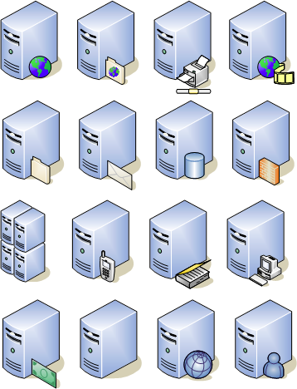
The Traditional Server Concept (cont.)
Pros
  Easy to conceptualize
  Fairly easy to deploy
  Easy to backup
  Virtually any application/service can be run from this type of setup
Cons
  Expensive to acquire and maintain hardware
  Not very scalable
  Difficult to replicate
  Redundancy is difficult to implement
  Vulnerable to hardware outages
  In many cases, processor is under-utilized

Slide 37
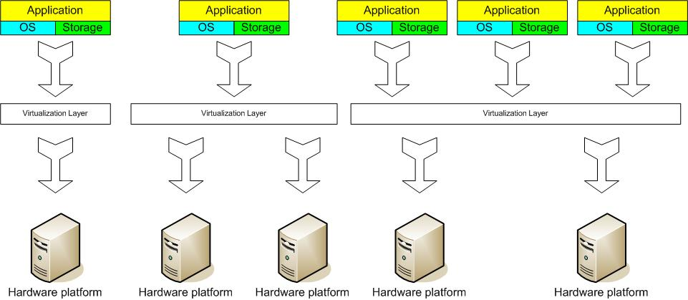
The Virtual Server Concept
Virtual Machine Monitor (VMM) layer between Guest OS and hardware

Slide 38
Close-up
* adapted from a diagram in VMware white paper, Virtualization Overview
Server
1
Guest OS
Server
2
Guest OS
Clustering
Service Console
VMM (Virtual Machine Monitor)
x86 Architecture
Intercepts hardware requests

Slide 39
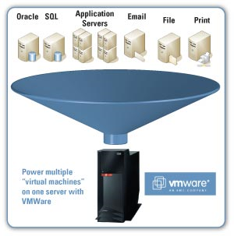
The Virtual Server Concept (cont.)
Virtual servers seek to encapsulate the server software away from the hardware
Servers end up as mere files stored on a physical box, or in enterprise storage.
A virtual server can be serviced by one or more hosts, and one host may house more than one virtual server.

Slide 40
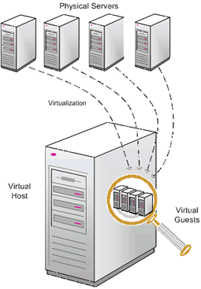
The Virtual Server Concept (cont.)
Virtual servers can still be referred to by their function i.e. email server, database server, etc.
If the environment is built correctly, virtual servers will not be affected by the loss of a host.
Hosts may be removed and introduced almost at will to accommodate maintenance.

Slide 41
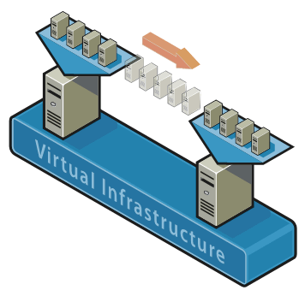
The Virtual Server Concept (cont.)
Virtual servers can be scaled out easily.
Server templates can be created in a virtual environment to be used to create multiple, identical virtual servers
Virtual servers themselves can be migrated from host to host almost at will.
Notes:
Virtual servers can be scaled out easily.
If the administrators find that the resources supporting
a virtual server are being taxed too much, they can
adjust the amount of resources allocated to that virtual server

Slide 42
The Virtual Server Concept (cont.)
Pros
  Resource pooling
  Highly redundant
  Highly available
  Rapidly deploy new servers
  Easy to deploy
  Reconfigurable while services are running
  Optimizes physical resources by doing more with less
Cons
  Slightly harder to conceptualize
  Slightly more costly (must buy hardware, OS, Apps, and now the abstraction layer)

Slide 43
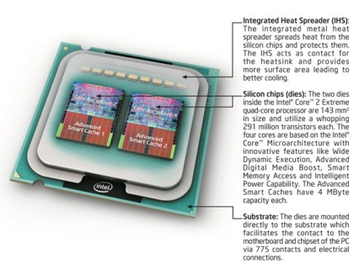
Virtualization Status
Offerings from many companies
  e.g. VMware, Microsoft, Sun, ...
Hardware support
  Fits well with the move to 64 bit (very large memories) multi-core (concurrency) processors.
  Intel VT (Virtualization Technology) provides hardware to support the Virtual Machine Monitor layer
Virtualization is now a well-established technology

Slide 44
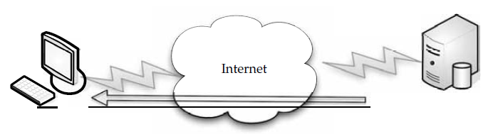
Infrastructure as a Service
Infrastructure is a way to deliver virtualization to your cloud computing solution
In a virtualized environment, applications run on a server and are displayed on the client. The server can be local or on the other side of the cloud.
Notes:
Infrastructure is a way to deliver virtualization to your cloud computing solution. We talked about virtualization before, both across the Internet (having your machines running on a remote server and displayed at your organization) and locally (having your clients’ sessions run on a local server and displayed at their desktops).
In this section we’ll talk about how virtualization—a fairly new computing solution—is being standardized and how major players are working and playing together to make it come together.

Slide 45
Outline
Infrastructure
Software
Services
Applications
Summary

Slide 46
Software
Software as a service (SaaS)
  Overview
  Company Offerings
    Google
    Microsoft
    IBM
Software plus service
  Overview
    Pros
    Cons
  Mobile Device Integration
    Providers
Notes:
Software as a Service (SaaS) is what traditionally comes to mind when we think of cloud
computing. In SaaS, an application is hosted by a service provider and then accessed via the WWW
by a client. In this sectoin we’ll look under the hood of SaaS and examine the pros and
cons of it. We will also talk about how specific vendors are offering SaaS, and then how SaaS
exists in different industries.

Slide 47
Software-Overview (1/4)
Cloud computing offering
  increasing abstraction of the underlying hardware,
  a related, but separate, set of decisions must be made concerning how the software and applications are deployed on cloud infrastructure.
Cloud software deployment realize
  efficient resource allocation
  re-use
  management

Slide 48
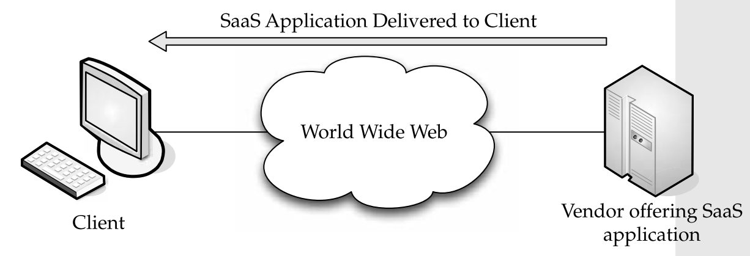
Software-Overview (2/4)
SaaS (Software as a Service) is
  an application hosted on a remote server and accessed through the Internet.
Notes:
這張圖的講解
An easy way to think of SaaS is the web-based email service offered by such companies
as Microsoft (Hotmail), Google (Gmail), and Yahoo! (Yahoo Mail). Each mail service meets
the basic criteria: the vendor (Microsoft, Yahoo, and so on) hosts all of the programs and
data in a central location, providing end users with access to the data and software, which is
accessed across the World Wide Web.

Slide 49
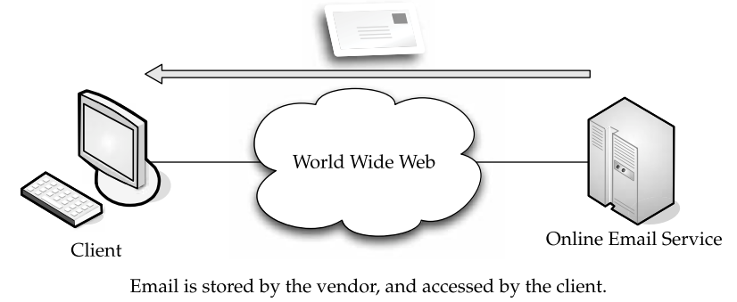
Software-Overview (3/4)
SaaS can be divided into
  Line of business services
  Customer-oriented services
Notes:
This is a simple explanation of SaaS, but the same architecture can be applied to a broad
variety of applications, used either by businesses or individual end users.
SaaS can be divided into two major categories:
• Line of business services
These are business solutions offered to companies and
enterprises. They are sold via a subscription service. Applications covered under this
category include business processes, like supply-chain management applications,
customer relations applications, and similar business-oriented tools.
• Customer-oriented services
These services are offered to the general public on a
subscription basis. More often than not, however, they are offered for free and
supported by advertising. Examples in this category include the aforementioned
web mail services, online gaming, and consumer banking, among others.

Slide 50
Software-Overview (4/4)
The advantages of SaaS
  Saving more time for value and improved productivity
  Lower software licensing costs.
  Saving enormous costs about installed software
  SaaS can be used to avoid the custom development cycles to get applications to the organization quickly.
  SaaS vendors typically have very meticulous security audits.
Notes:
• There’s a faster time to value and improved productivity, when compared to the long
implementation cycles and failure rate of enterprise software.
• There are lower software licensing costs.
• SaaS offerings feature the biggest cost savings over installed software by eliminating
the need for enterprises to install and maintain hardware, pay labor costs, and
maintain the applications.
• SaaS can be used to avoid the custom development cycles to get applications to the
organization quickly.
• SaaS vendors typically have very meticulous security audits.

Slide 51
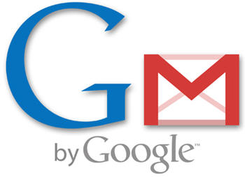


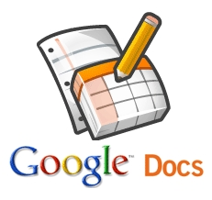
  Software-Company Offerings (1/3)
Google Apps
  Gmail
    webmail services
  Google Calendar
    shared calendaring
  Google Talk
    instant messaging and Voice over IP,
  Start Page feature
    Create a customizable home page on a specific domain.
  Google Docs
    Create and share work online and access
    documents from anywhere

Slide 52
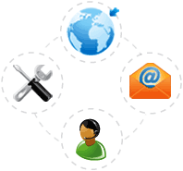
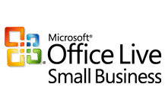
Software-Company Offerings (2/3)
Microsoft Office Live Small Business
  Store Manager
    an e-commerce tool to help small businesses easily sell products on their own web site and on eBay
  E-mail Marketing beta
    to make sending email newsletters and promotions simple and affordable.

Slide 53
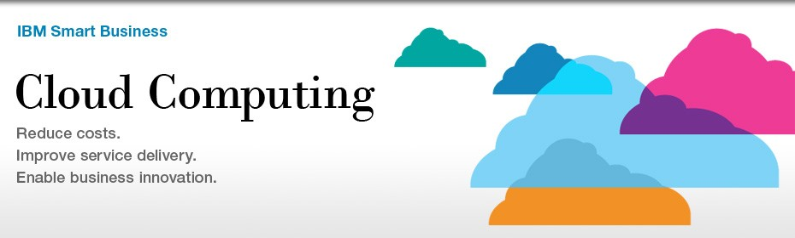
Software-Company Offerings (3/3)
IBM-Blue Cloud
  Allow corporate datacenters to operate more like the Internet
  Enabling computing across a distributed, globally accessible fabric of resources, rather than on local machines or remote server farms.

Slide 54
Software
Software as a service (SaaS)
  Overview
  Company Offerings
    Google
    Microsoft
    IBM
Software plus service
  Overview
  Mobile Device Integration
    Providers
Notes:
Up to this point we have talked about organizational IT design in absolute terms—
either you store your applications and data locally, or you employ a cloud solution.
We didn’t talk about any middle ground. It certainly would be nice to have the
flexibility to mix and match, to use the best of both worlds in a way that better suits your
requirements. The good news is that you can have it your way.
The answer is Software plus Services. In this architecture, you maintain some software
on-site, which accesses data stored on the cloud. This is especially good for remote workers,
road warriors, telecommuters, and anyone else who needs to be away from the corporate
datacenter.

Slide 55
Software plus Services
Overview (1/2)
Some ways to complement packaged software for helping organization
  User experience
  Working offline
  Privacy worries
  Marketing
  Power
  Flexibility
Notes:
In a nutshell, Software plus Services takes the notion of Software as a Service (SaaS) to
complement packaged software. Here are some of the ways in which it can help your
organization:
•User experience
Browsers have limitations as to just how rich the user experience can be. Combining client
software that provides the features you want with the ability of the Internet to deliver those experiences
gives you the best of both worlds.
•Working offline
Not having to always work online gives you the flexibility to do your work,
but without the limitations of the system being unusable. By connecting occasionally and
synching data, you get a good solution for road warriors and telecommuters who don’t
have the same bandwidth or can’t always be connected.
•Privacy worries
No matter how you use the cloud, privacy is a major concern. With Software plus Services,
you can keep the most sensitive data housed on-site, while less sensitive data can be moved to the cloud.
• Marketing
Software plus Services gives vendors a chance to keep their names in front of clients.
Since it’s so easy to move from vendor to vendor, providing a part-
software/part-Internet solution makes it easier to sell your product to a client.
• Power
More efficiency is realized by running software locally and synching to the
cloud as needed.
• Flexibility
Vendors can offer software in different sizes and shapes—whether on-
site or hosted. This gives customers an opportunity to have the right-sized solution.

Slide 56
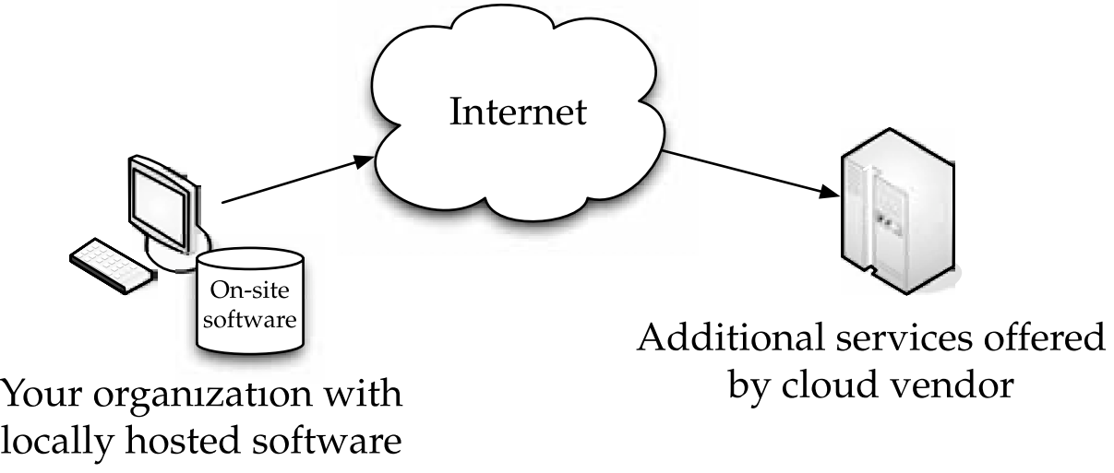
Software plus Services
Overview (2/2)
With Software plus Services, locally hosted software is supplemented by cloud offerings.

Slide 57
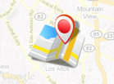
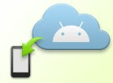


Mobile Device Integration
Google Android
  Google APIs add-on
    extends your Android SDK to give your applications access to Google libraries such as Maps.
  Android Cloud to Device Messaging
    a service that allows you to send lightweight messages from your application server to an Android application on a device.
Notes:
A key component of Software plus Services is the ability to work in the cloud from a mobile
device. But what do you need to put on the cloud? It really depends on your organization.
There are a number of free applications that you can use on the cloud. Take, for instance,
Google’s free apps. You can start a document at your PC and then share it with others or
continue working on it on your mobile device.
This is a simplistic example, but it shows how you can use the cloud to your advantage,
especially with mobile users.

Slide 58
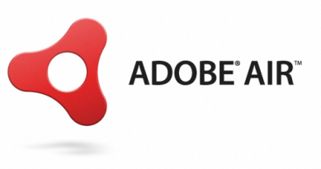
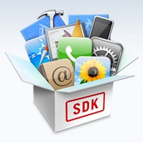
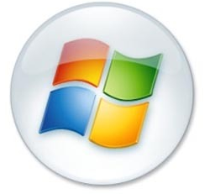
Other Mobile Device Integration Providers
Adobe AIR
  a cross-operating system runtime
  lets developers combine HTML, Ajax, Adobe Flash®, and Adobe Flex® technologies to deploy rich Internet applications (RIAs) on the desktop
Apple iPhone SDK
  includes a complete set of development tools for creating applications for iPad, iPhone, and iPod touch.
Microsoft Online
Notes:
Adobe AIR
The Adobe® AIR® 2 runtime enables developers to use HTML, JavaScript, Adobe Flash® software, and ActionScript® to build web applications that run as standalone client applications without the constraints of a browser. Adobe AIR and the Adobe Flash Platform unleash the creativity of designers and developers by providing a consistent and flexible development environment for the delivery of applications across devices and platforms. Support for additional platforms, including Android, is under development.
Apple iPhone SDK
iPhone SDK 4 includes a complete set of development tools for creating applications for iPad, iPhone, and iPod touch, including the Xcode IDE, iPhone Simulator, Instruments, Interface Builder, and more.

Slide 59
Outline
Infrastructure
Software
Services
Applications
Summary

Slide 60
Services
What is “as a service”?
  Low barriers to entry
    making them available to small businesses.
  Large scalability
  Multitenancy
    allows resources to be shared by many users.
  Device independence
    which allows users to access the systems on different hardware
Notes:
The term “services” in cloud computing is the concept of being able to use reusable, finegrained components across a vendor’s network. This is widely known as “as a service.”Offerings with as a service as a suffix include traits like the following: 以下接這張投影片上的要點

Slide 61
Services
Cloud Computing Services
  Infrastructure as a Service(IaaS)
    Amazon EC2
    GoGrid
  Platform as a Service(PaaS)
    RightScale
  Software as a Service(SaaS)
    Salesforce.com
    Salesforce for Google Apps
  Software plus Services(SpS)
    Microsoft Online Services
Notes:
Any organization can benefit from the cloud in different guises. In this section we will talk
about the different ways an organization can utilize different services as well as how some
organizations are doing just that.

Slide 62
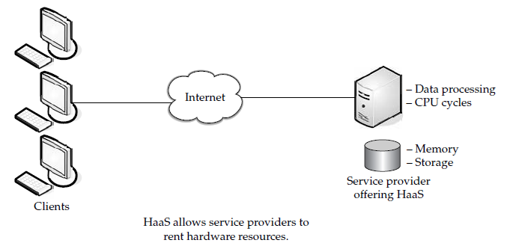
Infrastructure as a Service (1/6)
IaaS is sometimes also called Hardware as a Service (HaaS).
Just offers the hardware for customers to rent
  Server space
  Network equipment
  Memory
  CPU cycles
  Storage space
Notes:
Later, we will talk about SaaS and PaaS, both of them are providing applications to customers. But IaaS doesn’t. It simply
offers the hardware so that your organization can put whatever they want onto it.

Slide 63
Infrastructure as a Service (2/6)
IaaS involves several pieces:
  Service level agreements
  Computer hardware
  Network
  Internet connectivity
  Platform virtualization environment
  Utility computing billing
Notes:
•Service level agreements
This is an agreement between the provider and client,
guaranteeing a certain level of performance from the system.
• Computer hardware
These are the components whose resources will be rented
out. Service providers often have this set up as a grid for easier scalability.
• Network
This includes hardware for firewalls, routers, load balancing, and so on.
• Internet connectivity
This allows clients to access the hardware from their own organizations.
• Platform virtualization environment
This allows the clients to run the virtual
machines they want.
• Utility computing billing
Typically set up to bill customers based on how many
system resources they use.

Slide 64

  Infrastructure as a Service (3/6)
Amazon EC2
  Amazon Elastic Compute Cloud
A web service that
  provides resizable computing capacity in the cloud.
  allows businesses to obtain and configure capacity with minimal friction.
  provides control of computing resources and lets organizations run on Amazon’s computing environment.
Notes:
Let’s continue talking about Infrastructure as a Service. In this scenario, you’re using the cloud
provider’s machines. Another term for this type of computing is Everything as a Service.
That is, you are using a virtualized server and running software on it. One of the most prevalent is Amazon Elastic Compute Cloud (EC2). Another player in the field is GoGrid. In this section we’ll take a closer look at both Amazon and GoGrid.

Slide 65
Infrastructure as a Service (4/6)
Features of Amazon EC2
  Load balancing
  Auto-scaling
  Monitoring
  Management Console
Notes:
Load balancing
Enables customers to balance incoming requests and distribute traffic across multiple Amazon EC2 compute instances.
Auto-scaling
Automatically grows and shrinks usage of Amazon EC2 compute capacity based on application requirements.
Monitoring
Enables customers to monitor operational metrics of Amazon EC2,providing even better visibility into usage of the AWS cloud.
Management Console
Provides a simple, point-and-click web interface that lets customers manage and access their AWS cloud resources.

Slide 66
Infrastructure as a Service (5/6)
Capabilities of Amazon EC2
Dynamically allocate and terminate Linux “virtual” machines with a variety of hardware configurations.
Pay only for what you use (i.e. machine hours and data transfer)
Ability to capture software configurations into Amazon Machine Images (AMI) for later use.
Notes:
AMI is a read-only filesystem image which includes an operating system (e.g., Linux, UNIX, or Windows) and any additional software required to deliver a service or a portion of it.

Slide 67

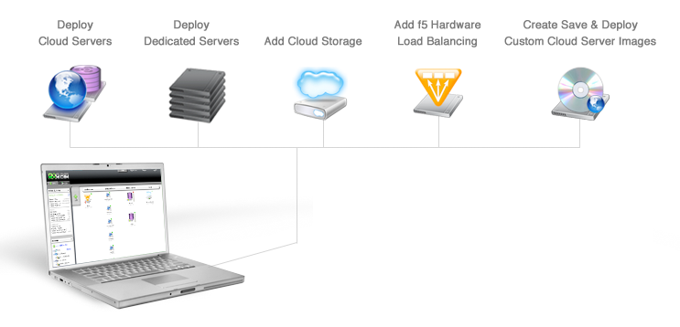
Infrastructure as a Service (6/6)
GoGrid
  A service provider of Windows and Linux cloud-based server hosting
  one of the first Infrastructure as a Service (IaaS) providers to offer Windows Server 2008 “in the cloud.
  Build and Scale Cloud Infrastructure in Real-time.
Notes:
GoGrid is an Infrastructure as a Service (IaaS) cloud provider. Configuring and managing infrastructure in the GoGrid cloud is similar to managing infrastructure in a corporate data center or with a dedicated server or colocation service provider. GoGrid infrastructure is accessed and operated using standard network protocols and IP addresses over the internet. No new technical skills or specialized equipment is required to get started.

Slide 68
Services
Cloud Computing Services
  Infrastructure as a Service(IaaS)
    Amazon EC2
    GoGrid
  Platform as a Service(PaaS)
    RightScale
  Software as a Service(SaaS)
    Salesforce.com
    Salesforce for Google Apps
  Software plus Services(SpS)
    Microsoft Online Services
Notes:
Any organization can benefit from the cloud in different guises. In this section we will talk
about the different ways an organization can utilize different services as well as how some
organizations are doing just that.

Slide 69
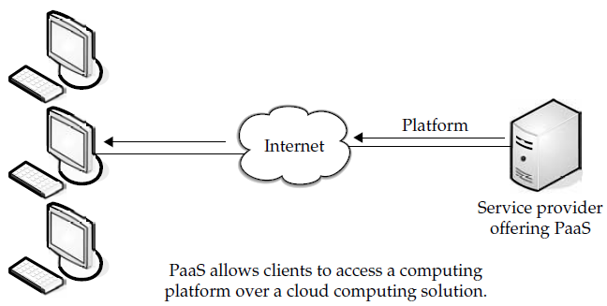
Platform as a Service (1/5)
PaaS
  supplies all the resources required to build applications and services completely from the Internet
  without having to download or install software
Notes:
PaaS is also known as cloudware

Slide 70
Platform as a Service (2/5)
PaaS services include
  Application design
  Development
  Testing
  Deployment
  Hosting
PaaS is normally based on
  HTML
  JavaScript
    to help the creation of user interfaces
Notes:
除投這張影片寫的之外
PaaS services also include team collaboration, web service integration, database integration, security, scalability, storage, state management, and versioning.
PaaS generally offers some support to help the creation of user interfaces, and is normally based on HTML or JavaScript.

Slide 71
Platform as a Service (3/5)
PaaS also supports web development interfaces such as
  Simple Object Access Protocol (SOAP)
  Representational State Transfer (REST)
    mashups
    access databases
    resuse services
PaaS is found in one of three different types of systems
  Add-on development facilities
  Stand-alone environments
  Application delivery-only environments
Notes:
PaaS also supports web development interfaces such as Simple Object Access Protocol (SOAP) and Representational State Transfer (REST), which allow the construction of multiple web services, sometimes called mashups. The interfaces are also able to access
databases and reuse services that are within a private network.
PaaS is found in one of three different types of systems:
• Add-on development facilities
These allow existing SaaS applications to be customized. Often, PaaS developers and users are required to purchase subscriptions to the add-on SaaS application.
• Stand-alone environments
These environments do not include licensing, technical, or financial dependencies on specific SaaS applications and are used for
general developments.
• Application delivery-only environments
These environments support hostinglevel services, like security and on-demand scalability. They do not include
development, debugging, and test capabilities.

Slide 72

  Platform as a Service (4/5)
RightScale
  a web based cloud computing management platform for managing cloud infrastructure from multiple providers.
  It offers significant advantages over alternative cloud management approaches.
    Cloud-Ready ServerTemplates
    Managing Deployments
    Automation Across the Deployment Lifecycle
    Transparency and Control
    Eliminate Lock-in with Cloud Portability
Notes:
Platform as a Service (PaaS) is a way to build applications and have them hosted by the
cloud provider. It allows you to deploy applications without having to spend the money to
buy the servers on which to house them. In this section I will introduce
RightScale.
Cloud-Ready ServerTemplates – Even if you have minimal knowledge of cloud architectures, you can take advantage of RightScale』s pre-packaged ServerTemplates to get up and running on the cloud fast. Available for a wide variety of common application scenarios, ServerTemplates incorporate best practice design architectures – so you can focus on your own application and trust in the reliability, resiliency, and performance of other more standard components.
Managing Deployments – Rather than managing individual servers, with the RightScale Platform you manage entire deployments – groups of servers architected to work together – saving you valuable systems administrative time and reducing costly errors.
Automation Across the Deployment Lifecycle – From autoscaling to remediation to automatic configuration, you can achieve a new level of ease in system administration of production deployments while also providing tools for managing multi-server deployments over their entire lifecycle.
Transparency and Control – With RightScale』s open architecture, you retain visibility into all levels of your cloud application. Manage, monitor, test, troubleshoot, and re-launch applications with total control. You can also store valuable operations runbook knowledge and break free from the limits of virtual machine images.
Eliminate Lock-in with Cloud Portability – Gain the freedom and flexibility to choose among a variety of development languages, software stacks, data stores, and cloud providers. Choose the right cloud infrastructure for your unique requirements, whether that involves security and regulatory compliance, geographic location, special features, or pricing. Manage and migrate deployments across clouds – public or private. With RightScale, you never get locked in.

Slide 73
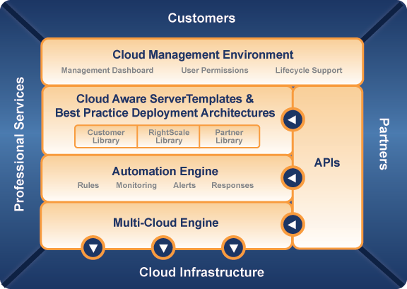
Platform as a Service(5/5)
The RightScale Cloud Management Platform
Notes:
RightScale
With the RightScale Cloud Management Platform, you can more easily deploy and manage business-critical applications on the cloud with new levels of automation, control, and portability. Whether you need a fast on-ramp to the cloud or support for complex deployments across multiple clouds, RightScale delivers.
Join the thousands of companies using RightScale to manage their applications on the cloud today.
Cloud Management Environment provides control, administration, and lifecycle support of your cloud deployments.
Cloud-Ready ServerTemplate and Best Practice Deployment Library gets you on the cloud quickly, provides best practices, and simplifies deployment management.
Adaptable Automation Engine enables your deployment to automatically adapt to events you specify in the way you want them handled.
Multi-cloud Engine interacts with cloud infrastructure APIs and manages the unique requirements of each cloud.
Readily Extensible Platform supports programmatic access to the functionality of the RightScale Platform.

Slide 74
Services
Cloud Computing Services
  Infrastructure as a Service(IaaS)
    Amazon EC2
    GoGrid
  Platform as a Service(PaaS)
    RightScale
  Software as a Service(SaaS)
    Salesforce.com
    Salesforce for Google Apps
  Software plus Services(SpS)
    Microsoft Online Services
Notes:
Any organization can benefit from the cloud in different guises. In this section we will talk
about the different ways an organization can utilize different services as well as how some
organizations are doing just that.

Slide 75
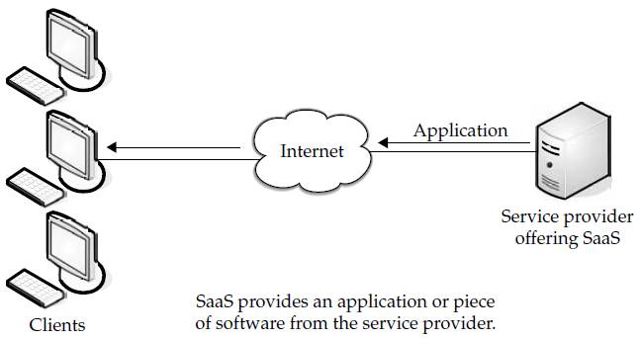
Software as a Service (1/5)
Software as a Service
  an application is hosted as a service
  the customer doesn’t have to maintain it or support off-site software
Notes:
Software as a Service (SaaS) is the model in which an application is hosted as a service to customers who access it via the Internet. When the software is hosted off-site, the customer doesn’t have to maintain it or support it. On the other hand, it is out of the customer’s hands when the hosting service decideds to change it. The idea is that you use the software out of
the box as is and do not need to make a lot of changes or require integration to other systems.
以下為這張圖片的解說
Costs can be sort of a double-edged sword. On the one hand, costs for accessing the software can be an ongoing thing. Rather than pay for it once and be done with it, the more you use it, the more you’ll be billed. On the other hand, in some cases you don’t have to pay as much up front and you are only billed based on your use of the application.

Slide 76
Software as a Service (2/5)
Some of SaaS applications include
  Customer resource management (CRM)
  Video conferencing
  IT service management
  Accounting
  Web analytics
  Web content management
Notes:
下面這一串念完之後 就接本張投影片
There are many types of software that lend themselves to the SaaS model. Typically, software that performs a simple task without much need to interact with other systems makes them ideal candidates for SaaS. Customers who are not inclined to perform software
development but have need of high-powered applications can also benefit from SaaS. Some of these applications include …

Slide 77
Software as a Service (3/5)
Benefits of SaaS
  Familiarity with the World Wide Web .
  Smaller staff IT
  Better marketing
  Web reliability
  Security
    SSL
  More bandwidth
Notes:
One of the biggest benefits of SaaS is, of course, costing less money than buying the application outright. The service provider can offer cheaper, more reliable applications than organizations can by themselves. Some other benefits include the following:
• Familiarity with the World Wide Web
Most workers have access to a computer and know how to use it on the World Wide Web. As such, the learning curve for using external applications can be much smaller.
• Smaller staff IT
systems require the overhead of salaries, benefits, insurance, and
building space. The ability to farm out applications reduces the need for as much IT staff.
• Customization
Older applications were difficult to customize and required
tinkering with the code. SaaS applications are much easier to customize and can give an organization exactly what they want.
• Better marketing
A provider who had developed an application for a very narrow
market might have had problems marketing that application. However, with SaaS, the entire world is open to the providers.
• Web reliability
We talked earlier about how the World Wide Web can be seen as a
source of failure. And while that is sporadically true, the fact of the matter is that the Web is generally quite reliable.
• Security
Secure Sockets Layer (SSL) is widely used and trusted. This allows
customers to reach their applications securely without having to employ complex back-end configurations, like virtual private networks (VPNs).
• More bandwidth
Bandwidth has increased greatly in recent months and quality
of service improvements are helping data flow. This will allow organizations to trust that they can access their applications with low latencies and good speeds.

Slide 78
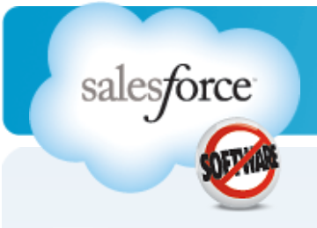
Software as a Service (4/5)
Salesforce.com
  founded in March 1999 by former Oracle executive Marc Benioff, Parker Harris, Dave Moellenhoff, and Frank Dominguez as a company specializing in SaaS software
  distributes business software on a subscription basis.
  hosts the applications offsite.
  It is best known for its Customer Relationship Management (CRM) products.
Notes:
The Force.com platform offers global infrastructure and services for database, logic, workflow, integration,
user interface, and application exchange.

Slide 79





Software as a Service (5/5)
Salesforce for Google Apps
  Salesforce and Gmail
  Salesforce and Google Docs
  Salesforce and Google Talk
  Salesforce and Google Calendar
Notes:
Salesforce for Google Apps is a combination of essential
applications for business productivity (email, calendaring, documents, spreadsheets,
presentations, instant messaging) and CRM (sales, marketing, service and support, partners)
that enables an entirely new way for business professionals to communicate, collaborate, and
work together in real time over the Web. Salesforce for Google Apps offers a complete way for
businesses to harness the power of cloud computing without the cost and complexity of
managing hardware or software infrastructure. The following features are included in
Salesforce for Google Apps:
• Salesforce and Gmail Businesses can now easily send, receive, and store email
communication, keeping a complete record of customer interactions for better sales
execution and improved customer satisfaction.
Salesforce for Google Apps could integrate Salesforce CRM with Google Apps
•Salesforce and Google Docs Create, manage, and share online Google
Documents, Google Spreadsheets, and Google Presentations within your sales
organization, marketing group, or support team for instant collaboration.
•Salesforce and Google Talk Instantly communicate with colleagues or customers
from Salesforce and optionally attach Google Talk conversations to customer or
prospect records stored in Salesforce.
•Salesforce and Google Calendar Expose sales tasks and marketing campaigns
from Salesforce on Google Calendar. Built by Appirio, this application is one
example of a new category of partner extensions to Salesforce for Google Apps.

Slide 80

Software plus Services
Microsoft Online Services
  Combine the power of rich desktop-based applications with the flexibility of fully-hosted Internet services
  Experience an all-in-one integrated experience on the same rich clients your users already know
  Delivers a consistent look and feel from virtually any device, in almost any location
  Includes business-class e-mail, instant messaging, and the latest messaging and collaboration features
Notes:
Microsoft’s take on SaaS is slightly different with their Software plus Services (sometimes they shorten it to S+S). In this model, typical SaaS is bolstered with software running locally.
That is, you run some software on-site and reach out to the cloud for additional services. This provides the flexibility of using a cloud provider, and also the reliability of having data stored on-site, as well.

Slide 81
Outline
Infrastructure
Middleware
Software
Services
Applications
Summary

Slide 82
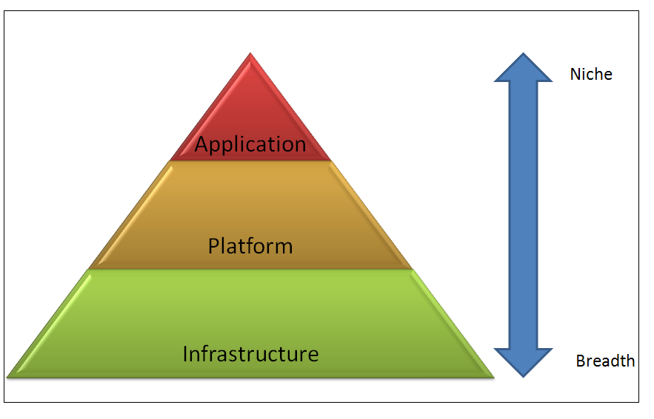
Applications

Slide 83
Applications (cont.)
Application Services(services on demand)
  Gmail, GoogleCalender
  Payroll, HR, CRM etc
  Sugarm CRM, IBM Lotus Live
Platform Services (resources on demand)
  Middleware, Intergation, Messaging, Information, connectivity etc
  AWS, IBM Virtual images, Boomi, CastIron, Google Appengine
Infrastructure as services(physical assets as services)
  IBM Blue house, VMWare, Amazon EC2, Microsoft Azure Platform, Sun Parascale and more

Slide 84
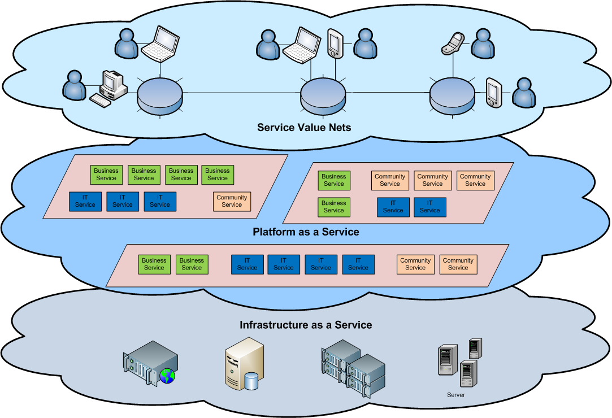
Cloud Architecture

Slide 85
Different Cloud Computing Layers‏
Application Service
(SaaS)‏
MS Live/ExchangeLabs, IBM,
Google Apps; Salesforce.com
Quicken Online, Zoho, Cisco
Google App Engine, Mosso,
Force.com, Engine Yard,
Facebook, Heroku, AWS
Application Platform
Server Platform
3Tera, EC2, SliceHost,
GoGrid, RightScale, Linode
Storage Platform
Amazon S3, Dell, Apple, ...

Slide 86
Cloud Computing Service Layers
Services
Description
Services
Services – Complete business services such as PayPal, OpenID, OAuth, Google Maps, Alexa
Application
Focused
Application
Application – Cloud based software that eliminates the need for local installation such as Google Apps, Microsoft Online
Development – Software development platforms used to build custom cloud based applications (PAAS & SAAS) such as SalesForce
Development
Platform
Platform – Cloud based platforms, typically provided using virtualization, such as Amazon ECC, Sun Grid
Infrastructure
Focused
Storage
Storage – Data storage or cloud based NAS such as CTERA, iDisk, CloudNAS
Hosting
Hosting – Physical data centers such as those run by IBM, HP, NaviSite, etc.

Slide 87




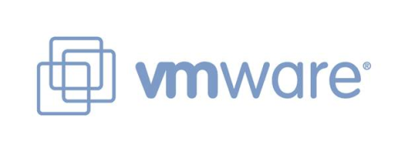













Commercial clouds

Slide 88
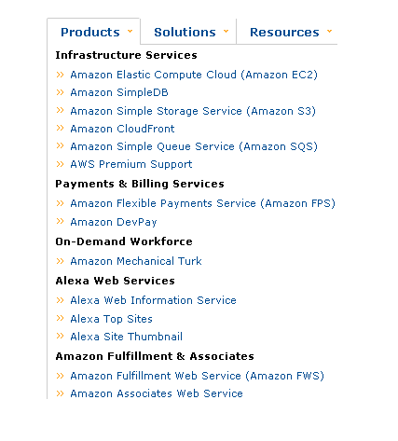
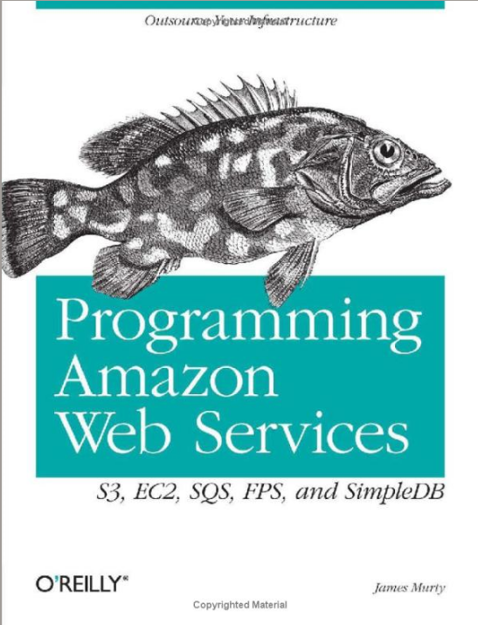
Amazon Web Services

Slide 89

Amazon Web Services
S3 - Simple Storage Service
CloudFfront
EC2 - Elastic Compute Cloud
SQS - Simple Queue Service
Premium Support:
- SimpleDB,
- Elastic MapReduce,
- Mechanical Turk,
- Workflow System.

Slide 90
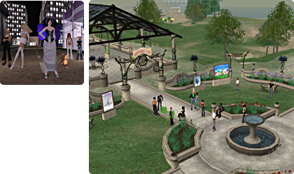
Amazon Simple Storage Service (S3)
Unlimited Storage.
Using the same scalable, reliable, fast infrastructure that Amazon uses.
Pay for what you use:
  $0.20 per GByte of data transferred,
  $0.15 per GByte-Month for storage used,
  Second Life Update:
    1TBytes, 40,000 downloads in 24 hours - $200,

Slide 91
Amazon Simple Storage Service (S3)
REST/SOAP based!
Flexible Download Protocol:
  HTTP,
  BitTorrent.
Implementations of the WS already made:
  NS3 Manager:
    .NET Based, Core Lib available for MS Build Tasks.
  S3sync
    Ruby Based,
    Works similar to rsync (for those familiar).
  S3Fox
    Firefox extension (if you use Firefox!).
  Jungle Disk (and other 3rd party ones):
    Work as WEBDAV, but interoperability issues!!

Slide 92
Utility Computing – EC2
Started in 2006:
  Amazon Elastic Compute Cloud (EC2):
    Elastic, marshal 1 to 100+ PCs via WS,
    Machine Specs…,
    Fairly cheap!
Powered by Xen – a Virtual Machine:
  Different from Vmware and VPC as uses “para-virtualization” where the guest OS is modified to use special hyper-calls:
    High performance!
  Hardware contributions by Intel (VT-x/Vanderpool) and AMD (AMD-V).
  Supports “Live Migration” of a virtual machine between hosts.
Pay by the hour from S(small), 0.10 $/h, to XL 0.80 $/h.
Linux, Windows, OpenSolaris.
Management Console/AP.

Slide 93
EC2 – The Basics
Load your image onto S3 and register it.
Boot your image from the Web Service.
Open up required ports for your image.
Connect to your image through SSH.
Execute you application…

Slide 94
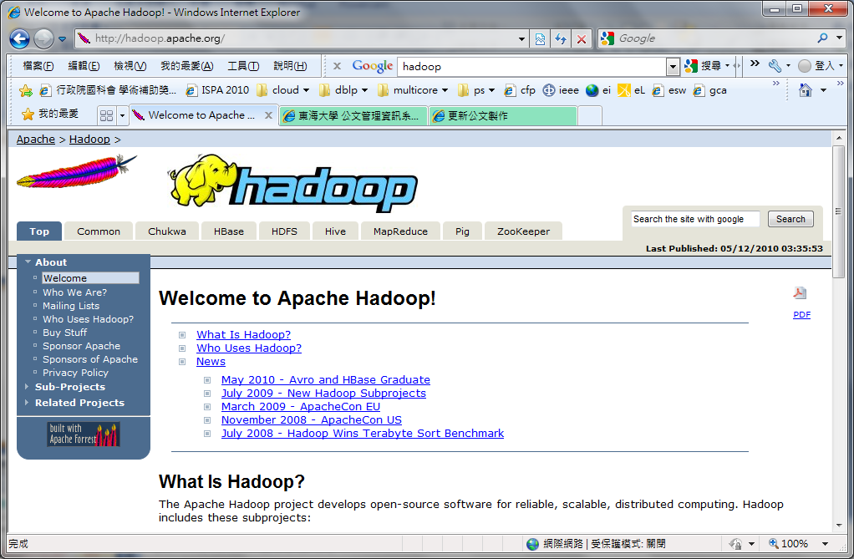
http://hadoop.apache.org/

Slide 95

Hadoop
Hadoop is a software framework that enables distributed manipulation of large amounts of data.
Hadoop does this in a way that makes it reliable, efficient, and scalable.
Hadoop is efficient because it works on the principle of parallelization, allowing data to process in parallel to increase the processing speed.
Hadoop is also scalable, permitting operations on petabytes of data.

Slide 96

Google: App Engine
Network platform, allowing developers can establish their own Web applications on the Google platform.
Support：
  500MB of storage
  up to 5 million page views a month
  10 applications per developer account
Limit：
  Language: Python, Java
  web applications
Notes:
網路平台，讓開發者可自行建立網路應用程式於google平台中。

Slide 97
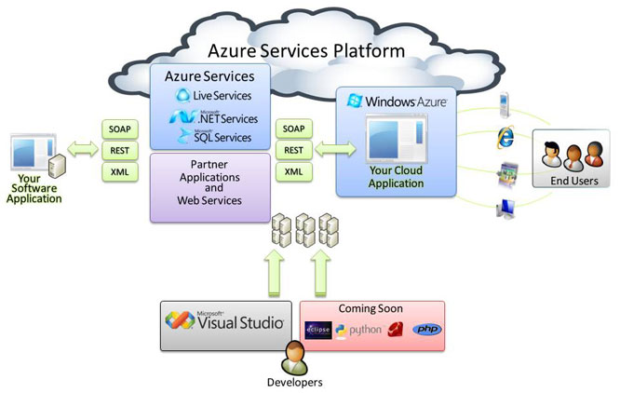
Windows: Azure
Windows Azure is a cloud services operating system. Azure Services Platform for the development, service hosting and service management environment.
.Net services
SQL services
Live services
Notes:
Windows Azure 是一套雲端服務作業系統。作為 Azure 服務平台的開發、服務代管及服務管理環境。

Slide 98

Yahoo: Hadoop
Apache item, Yahoo support, development and application
  2006 participation in open source cloud computing framework Hadoop, and its use in the internal service.
  2008 Feburary: the largest Hadoop application2 ,1000 servers
  Implementation of more than 10,000 Hadoop virtual machine
  5 Petabytes of content
  Analysis of 1 trillion web links
Notes:
2006年開始參與開源的雲端運算框架Hadoop，並將其使用在內部服務中。
2008年2：目前最大的Hadoop應用
2千臺伺服器
執行超過1萬個Hadoop虛擬機器
5 Petabytes的網頁內容
分析1兆個網路連結

Slide 99
Cloud Computing Industry
SaaS
Software as a Service
PaaS
Platform as a Service
IaaS
Infrastructure as a Service

Slide 100
Cloud Computing Industry
Infrastructure as a Service
Provides the core computational resources and network infrastructure services
Infrastructure stack:
  Full OS access
  Firewalls
  Routers
  Load balancing
IaaS
Notes:
100
Sometimes called Utility computing
提供了核心計算資源和網絡架構的服務
100

Slide 101
Cloud Computing Industry
Examples
Flexiscale
AWS: EC2 (Amazon Elastic Compute Cloud)
IaaS
Notes:
101
Sometimes called Utility computing
101

Slide 102
Cloud Computing Industry
Platform as a Service
Provide a platform for system administrators and developers that it is building, testing and deployment of custom applications
Management System is expensive
Popular services
  Storage
  Database
  Scalability
PaaS
IaaS
Notes:
提供平台給系統管理員和開發人員，以為它構建、測試及部署定製應用程序

Slide 103
Cloud Computing Industry
Examples
Google App Engine
AWS: S3 (Simple Storage Service)
Microsoft Azure
PaaS
IaaS

Slide 104
Cloud Computing Industry
SaaS
Software as a Service
Software through the Internet providing the model, the user to the provider of Web-based leasing software to manage business activities, with no need for software maintenance, service providers will fully manage and maintain software
PaaS
IaaS
Notes:
通過Internet提供軟體的模式，用戶向提供商租用基於Web的軟體，來管理企業經營活動，且無需對軟體進行維護，服務提供商會全權管理和維護軟體

Slide 105
Cloud Computing Industry
SaaS
Software as a Service
Without management of HW and SW
Easy to use (Brower)
Pay per use
Instant Scalability
Security
Reliability
PaaS
IaaS
Notes:
HW:硬體 sw:軟體 brower:瀏覽器

Slide 106
Cloud Computing Industry
Examples
Google Docs
CRM
Financial Planning
Human Resources
Word processing
Salesforce.com
SaaS
PaaS
IaaS

Slide 107
Comparisons
服務 屬性 | Amazon EC2 | Google App Engine | Microsoft Azure | Yahoo Hadoop
Architecture | Iaas/Paas | Paas | Paas | Software
Services Type | Compute/ Storage | Web application | Web and non-web | Software
Management Technol0gy | OS on Xen hypervisor | Application container | OS through Fabric controller | Map / Reduce Architecture
User Interface | EC2 Command-line tools | Web-based Administration console | Windows Azure portal | Command line and web
APIs | yes | yes | yes | yes
Charge | yes | maybe | yes | no
Program Language | AMI (Amazon Machine Image) | Python | .NET framework | Java,
Notes:
Cloud computing isn’t a one-size-fits-all affair. There are several different ways the infrastructure
can be deployed. The infrastructure will depend on the application and how the provider has
chosen to build the cloud solution. This is one of the key advantages for using the cloud. Your
needs might be so massive that the number of servers required far exceeds your desire or
budget to run those in-house. Alternatively, you may only need a sip of processing power, so
you don’t want to buy and run a dedicated server for the job. The cloud fits both needs.

Slide 108
Outline
Infrastructure
Software
Services
Applications
Summary

Slide 109
Summary
The use of the cloud provides a number of opportunities:
  It enables services to be used without any understanding of their infrastructure.
  Cloud computing works using economies of scale:
    It potentially lowers the outlay expense for start up companies, as they would no longer need to buy their own software or servers.
    Cost would be by on-demand pricing.
    Vendors and Service providers claim costs by establishing an ongoing revenue stream.
  Data and services are stored remotely but accessible from “anywhere”.

Slide 110
Summary (cont.)
In parallel there has been backlash against cloud computing
  Use of cloud computing means dependence on others and that could possibly limit flexibility and innovation:
  The others are likely become the bigger Internet companies like Google and IBM, who may monopolise the market.
  Some argue that this use of supercomputers is a return to the time of mainframe computing that the PC was a reaction against.
  There have been cases of users being locked out of accounts and losing access to data.
Notes:
Freedom of Information == FOI

Slide 111
Summary (cont.)
Security could prove to be a big issue:
  It is still unclear how safe out-sourced data is and when using these services ownership of data is not always clear.
There are also issues relating to policy and access:
  If your data is stored abroad whose FOI policy do you adhere to?
  What happens if the remote server goes down?
  How will you then access files?

Slide 112
Question and Answer
Thanks
ctyang@thu.edu.tw
http://web.thu.edu.tw/ctyang/

Slide 113
HW
Please compare and description the differences among Cluster computing , Grid Computing, and Cloud Computing.
Please list some examples for three levels (IaaS, PaaS, and SaaS) of services in Cloud computing.

